Slide 1
Higgs Properties Measurement based on H→ZZ*→4l with ATLAS
Haijun Yang
(Shanghai Jiao Tong University)
The 9th Workshop of TeV Physics Working Group
Sun Yat-sen University, Guangzhou, China
May 15-18, 2014

Slide 2
Outline
Standard Model and Discovery of Higgs Boson
Higgs Production and Decays at LHC
Event Selection of H → ZZ* → 4l
Measurement of Properties : mass, spin, CP, couplings
Summary
References:
PLB 726 pp.88-119, pp. 120-144 ATLAS-CONF-2013-013
ATLAS-CONF-2013-034
ATLAS-CONF-2014-009

Slide 3
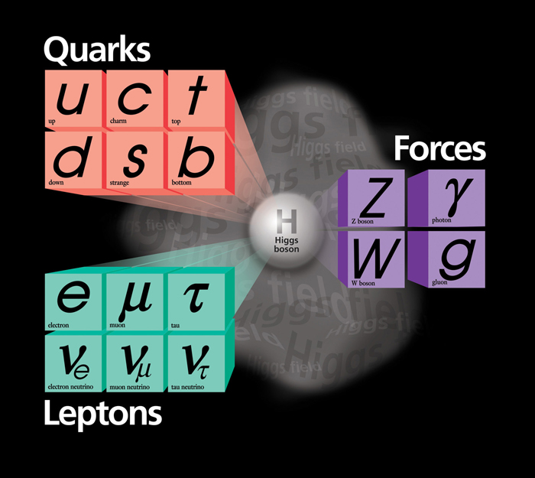
Standard Model and Discovery of the Higgs
Higgs boson is proposed to responsible for the electroweak symmetry breaking, particles acquire mass when interacting with the Higgs field.
The Higgs boson was discovered by ATLAS and CMS at LHC in July, 2012.
➔ F. Englert and P. Higgs won the Nobel Prize in Physics in 2013.

Slide 4
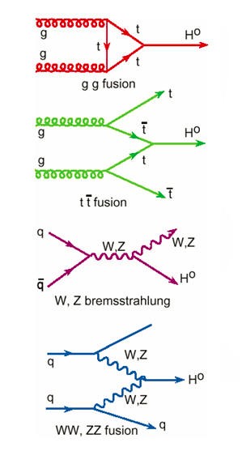
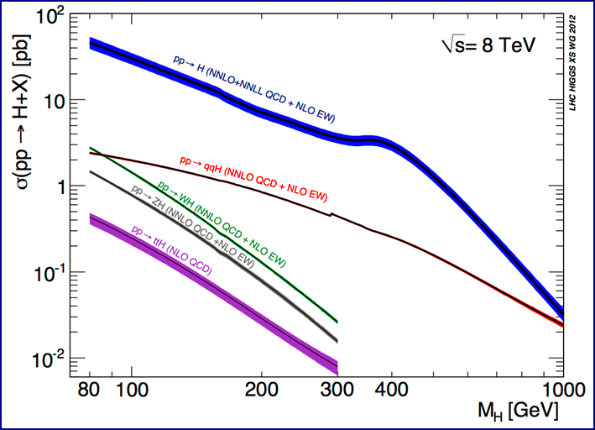
Higgs Boson Production at LHC
Gluon-gluon fusion gg→H and vector-boson
fusion qq→qqH are dominant
87%
0.5%
5%
7%
Yukawa
coupling
Gauge
coupling

Slide 5
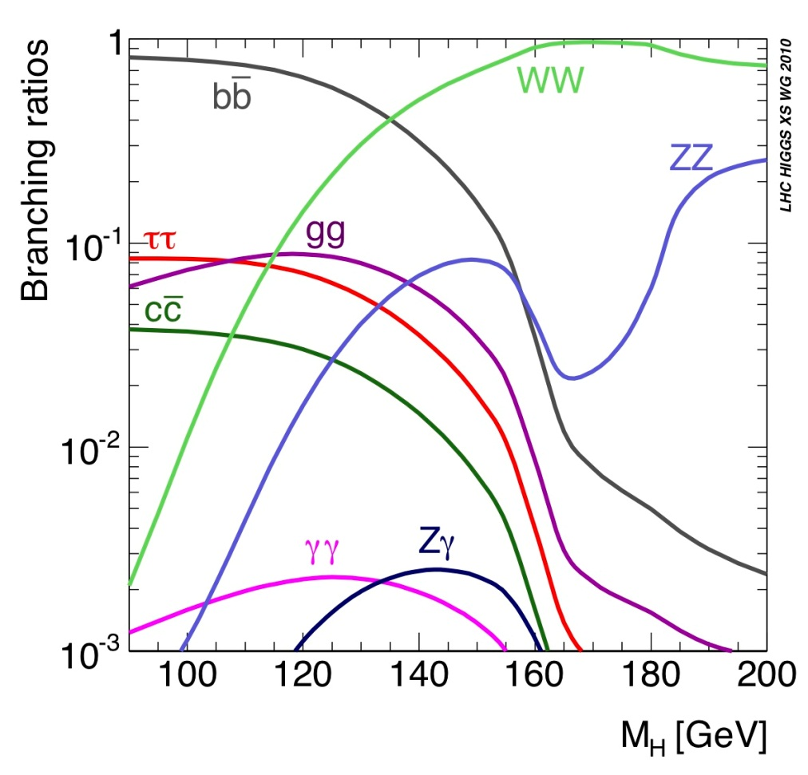
Higgs Boson Decay
Higgs decay branching
ratio at m_{H}=125 GeV
bb: 57.7% (huge QCD background)
WW: 21.5% (easy identification in di-lepton mode, complex background)
ττ: 6.3% (complex final states with τ leptonic and/or hadronic decays)
ZZ*: 2.6% (“gold-plated”, clean signature of 4-lepton, high S/B, excellent mass peak)
γγ: 0.23% (excellent mass resolution, high sensitivity)
H → ZZ* → 4l production rate:
1 out of 10¹³ collision events

Slide 6
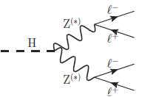
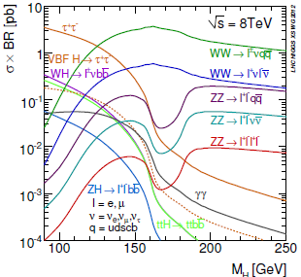
H→ZZ*→4l Overview
Extremely clean – “Gold-plated” channel
Fully reconstructed final states
Good mass resolution (~ 1.6-2.4 GeV)
High S/B ratio (~ 1-2)
Low decay branching fraction
Currently statistically limited
4.6 fb⁻¹ @ 7 TeV + 20.7 fb⁻¹ @ 8 TeV
Expect 68 SM H→ZZ*→4l (e,μ) events
Properties measurement
Higgs mass, spin, parity, couplings etc.
Critical to determine whether it is fully compatible with the SM Higgs boson

Slide 7
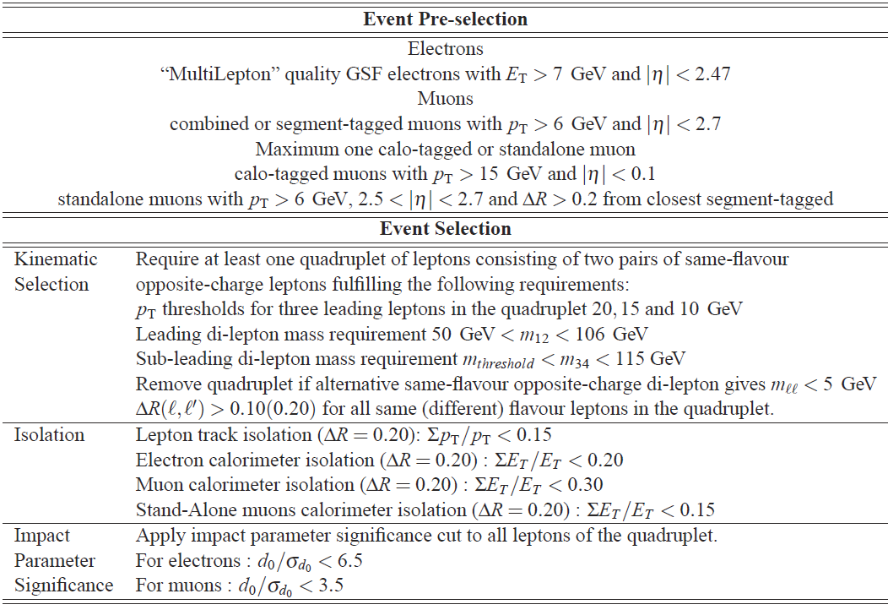
Event Selection
Trigger match with single and/or di-lepton trigger
Four sub-channels: 4e, 2e2μ, 2μ2e, 4μ

Slide 8
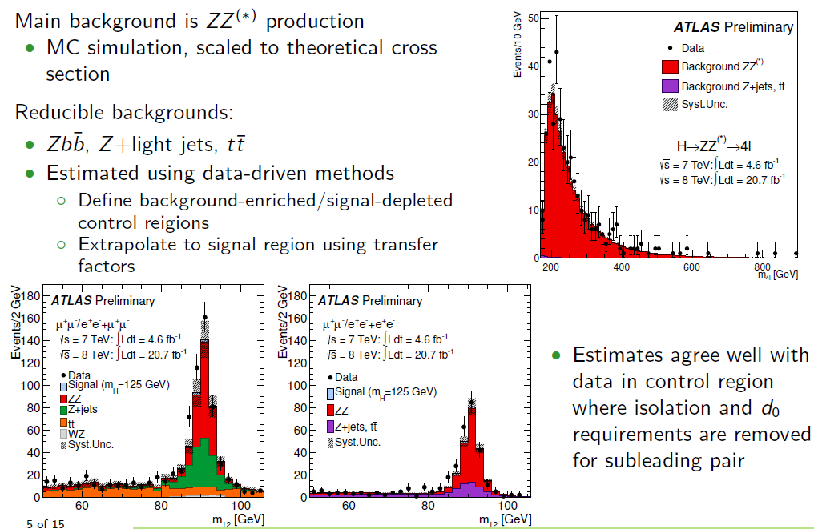
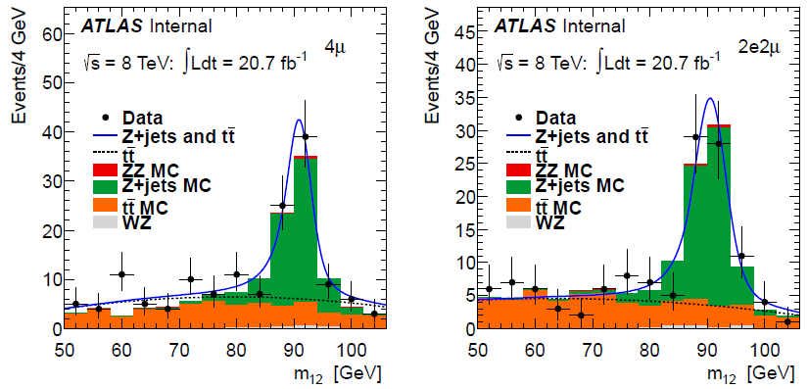
Background Estimation

Slide 9
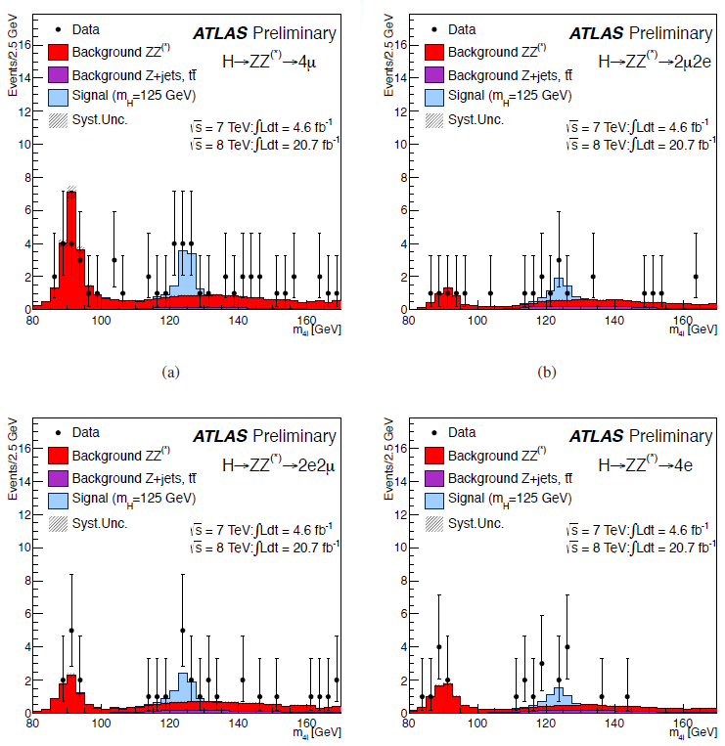
Invariant Mass of 4-lepton

Slide 10
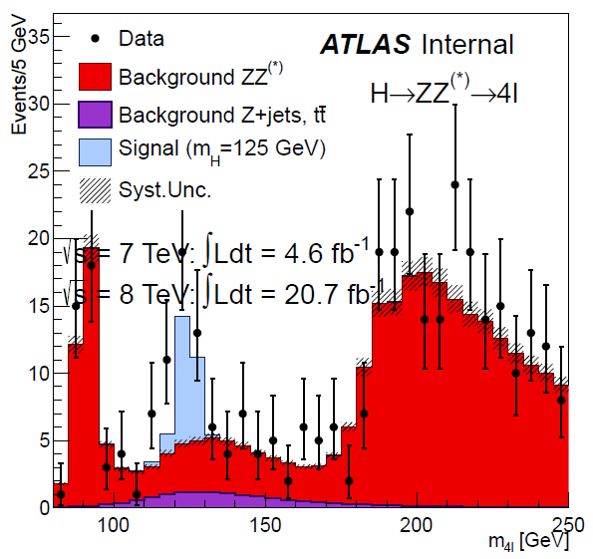
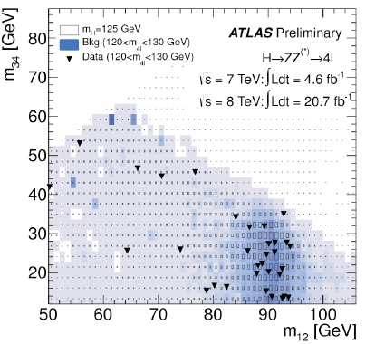
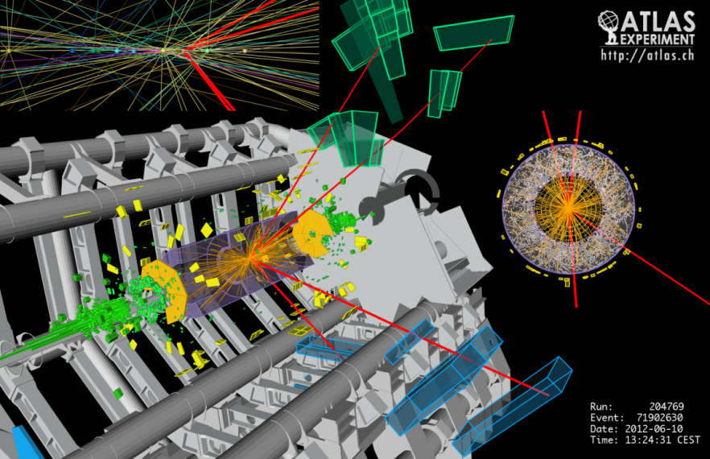
Selected Higgs Candidates
BR(H→ZZ*) = 2.63%, BR(ZZ*→4l)=0.45%
About 68 H→ ZZ*→4l events produced
Observed 32 candidates (16 Higgs signal)

Slide 11
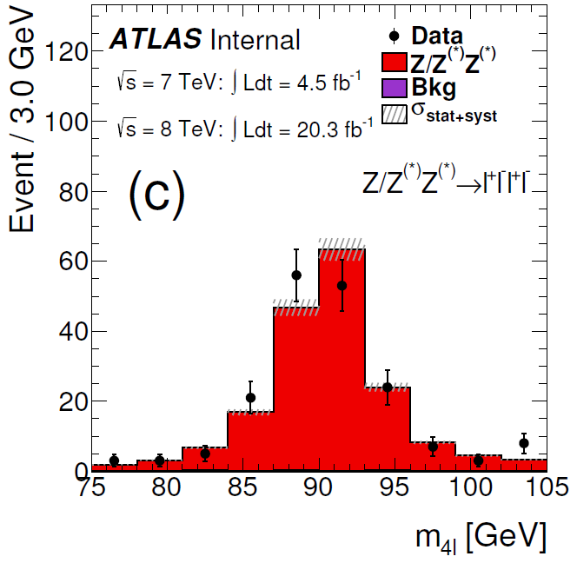
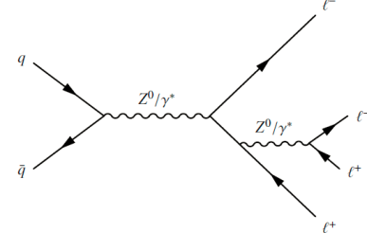
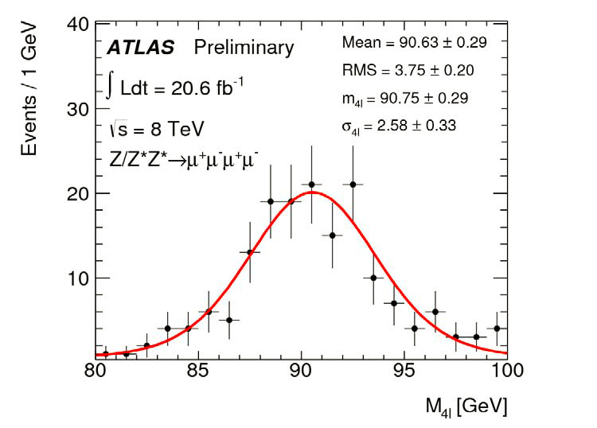
H→ZZ*→4l :Mass Calibration
BR(meas.)=(3.20±0.25±0.13)×10⁻⁶
BR(SM NLO)=(3.33±0.01)×10⁻⁶
σ_{(PS)}=107.3 ± 8.8 ± 4.0 ± 3.0 (fb)
(arXiv:1403.5657,
accepted by PRL on May 7, 2014)

Slide 12
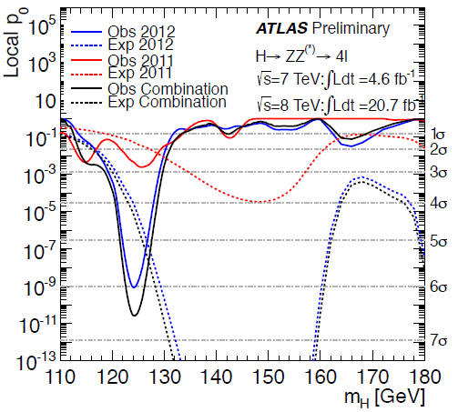
Higgs Detection Significance
Signal significance
6.6 σ (Measured)
4.4 σ (Expected)
➔ > 5σ discovery in
H→ZZ*→4l channel

Slide 13
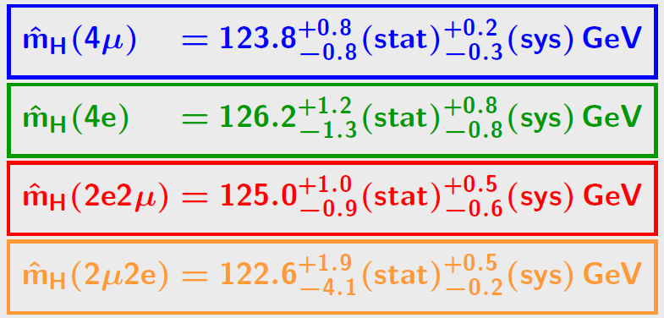
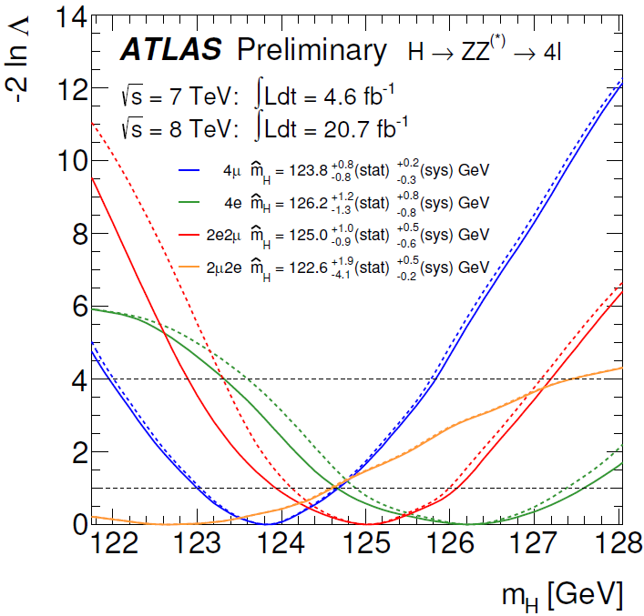
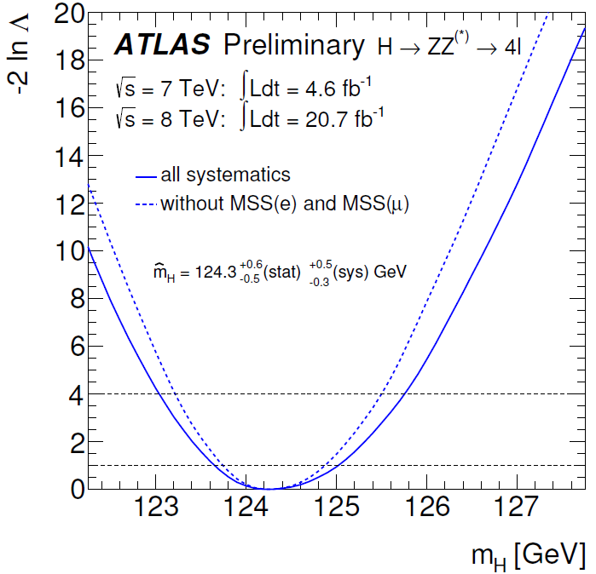
Higgs Mass Measurement

Slide 14
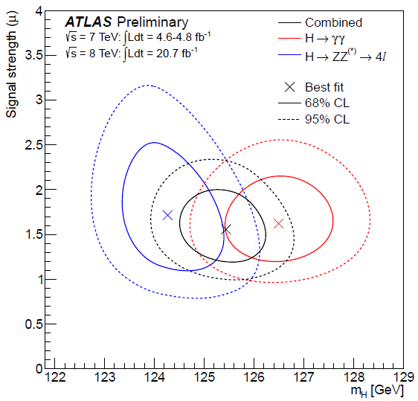
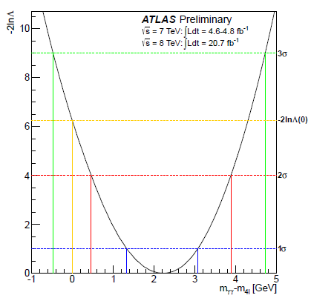
Higgs Mass Measurements
Combined mass
It is compatible with ΔM_{H} = 0 at
the level of 1.2%, 2.5σ

Slide 15
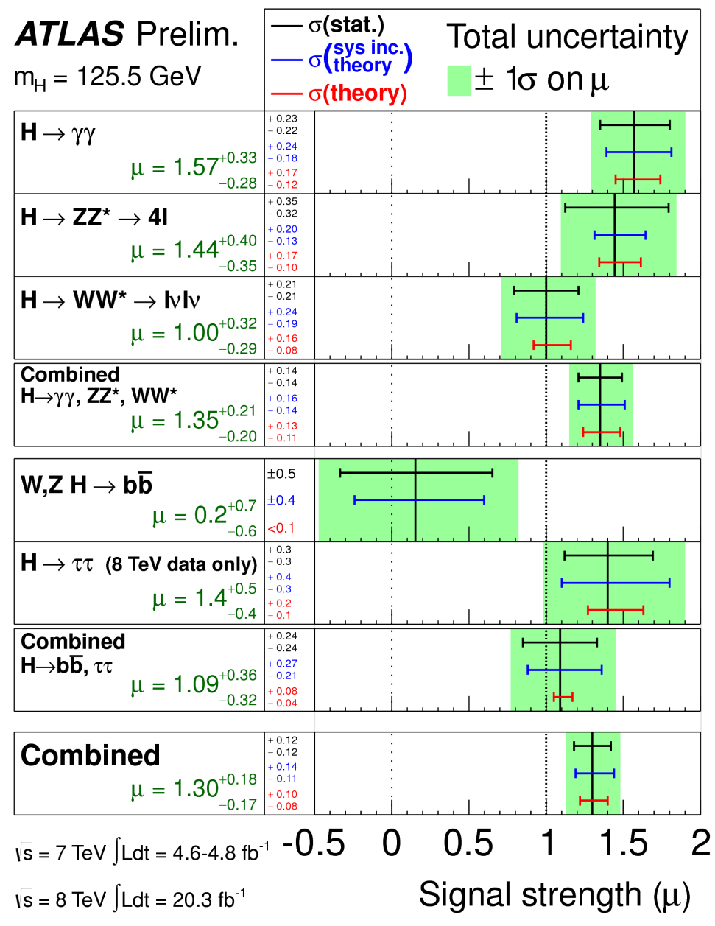
Measurements of Higgs Signal Strength
Signal strength for H→ZZ*→4l:
μ = 1.4±0.4
Combined signal strength
μ = 1.3±0.2 (ATLAS)
ATLAS-CONF-2014-009

Slide 16
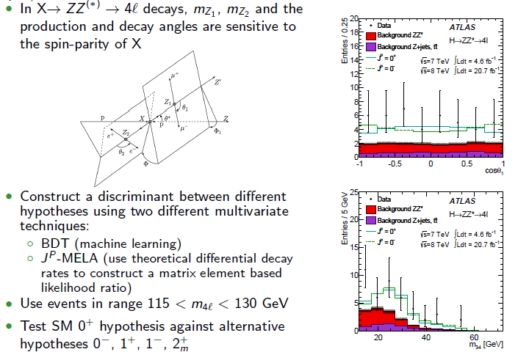
H→ZZ*→4l : Spin and Parity

Slide 17
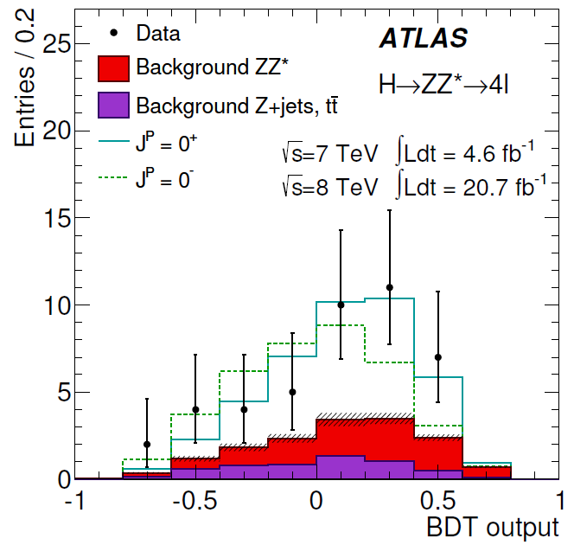
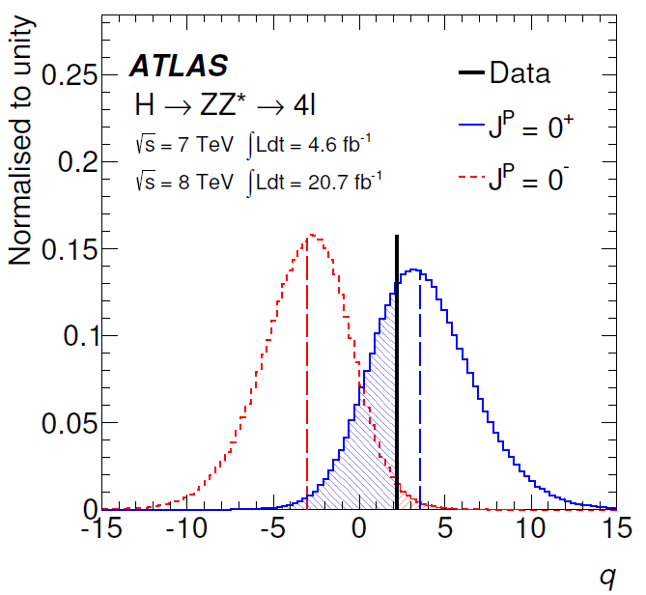
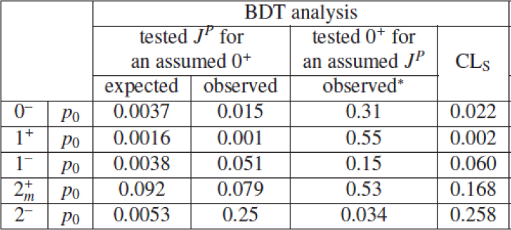
H→ZZ*→4l : Spin and Parity
0⁻
0⁺
MVA: m_{Z1}, m_{Z2} + decay angles
0⁺
0⁻
BDT analysis variables:
m_{Z1}, m_{Z2} from Higgs --> ZZ* →4l
+ production and decay angles
Exclusion (1-CL_{s} ):
Observed 0⁻ exclusion 97.8%
Observed 1⁺ exclusion 99.8%
Observed 2⁺_{m} exclusion 83.2%

Slide 18
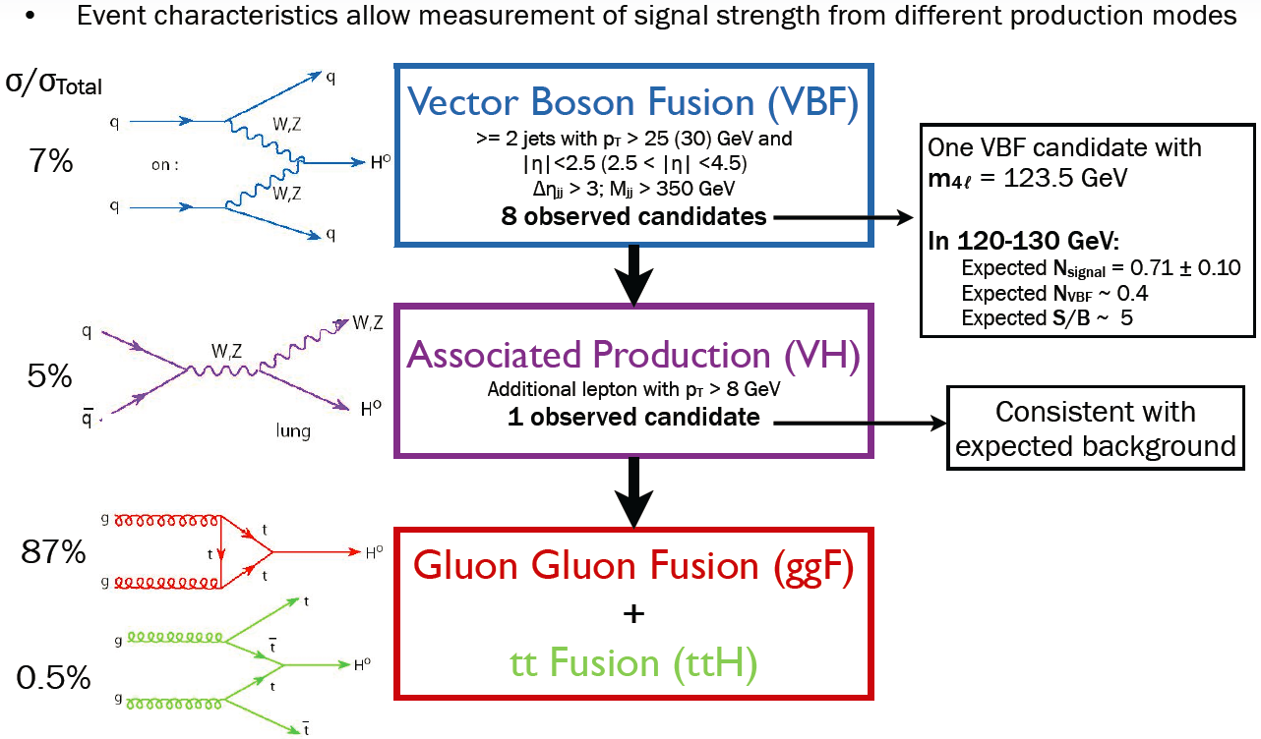
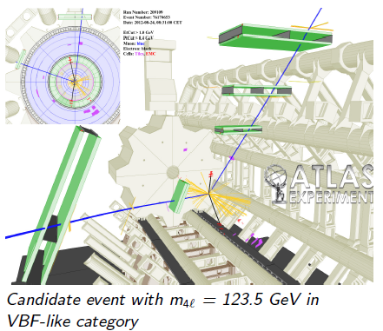
Probing Higgs Production

Slide 19
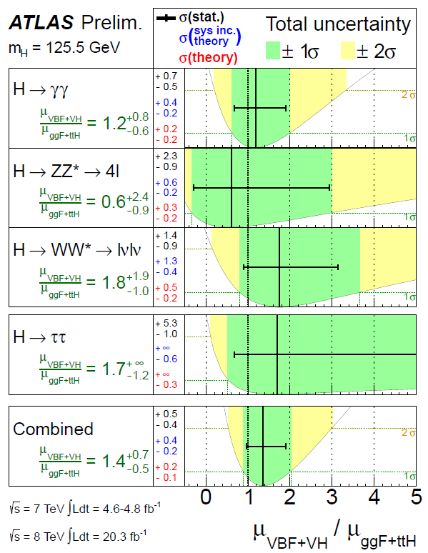
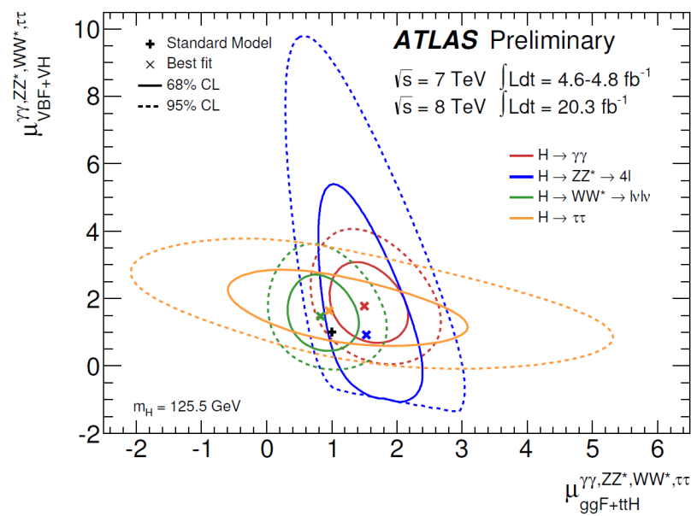
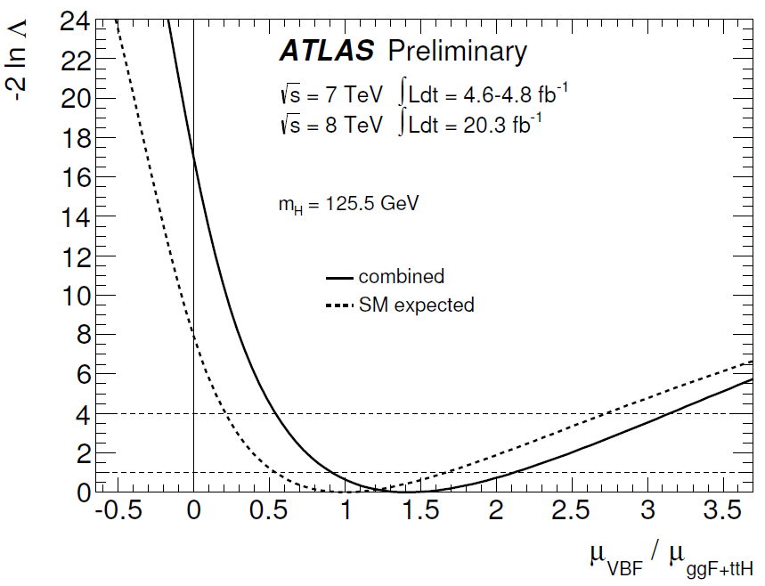
Higgs Production: ggF vs.VBF
μ_{VBF+VH} vs μ_{ggF+ttH} potentially modified by B/B_{SM}
Compatibility with μ_{VBF}=0 → 4.1σ

Slide 20
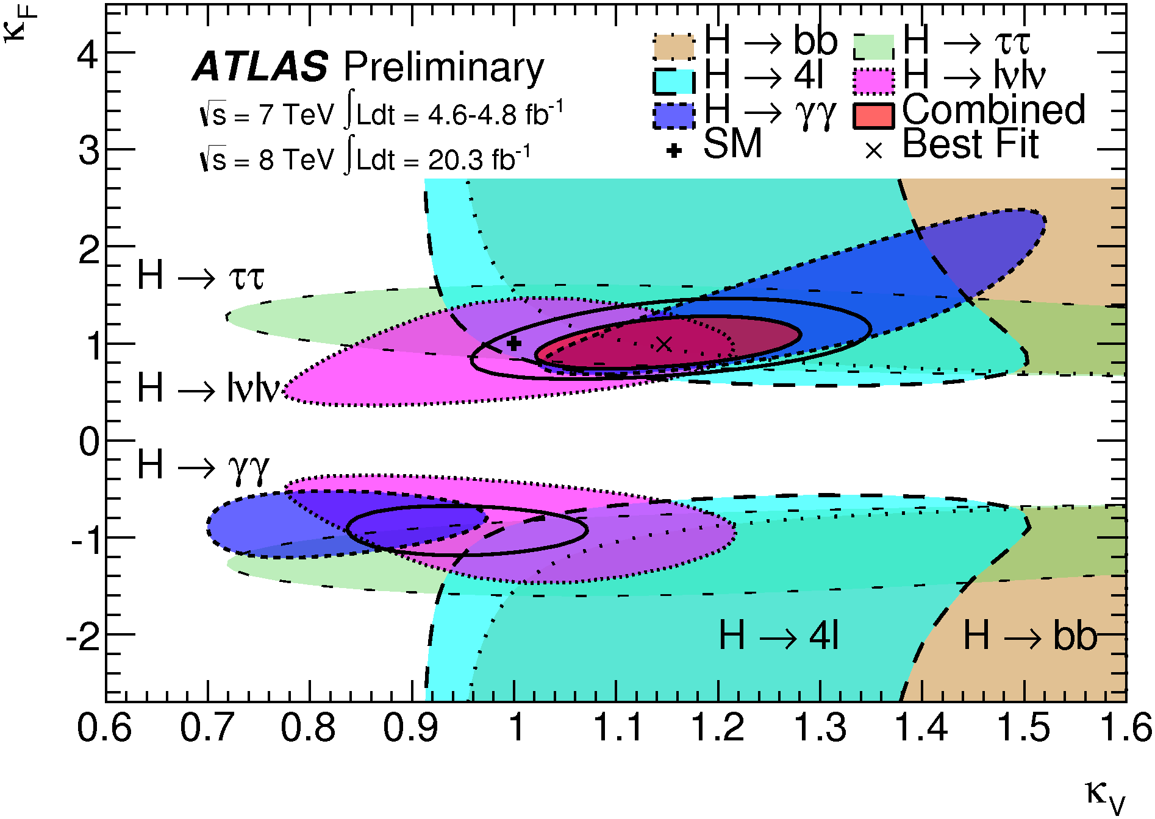
Fermion and Vector Couplings
Coupling scale factors
2-parameter benchmark model:
κ_{V} = κ_{W}=κ_{Z}
κ_{F} = κ_{t}=κ_{b}=κ_{c}=κ_{τ}=κ_{g}
(Gluon coupling are related to top, b, and their interference in tree level loop diagrams)
Assume no BSM contributions to loops: gg→ H and no BSM decays (no invisible decays)
➔ κ_{F} = 0 is excluded (>5σ)
See Xin Chen’s talk for
direct evidence of H→ ff

Slide 21
Summary
With 2011 (4.6 fb⁻¹ @ 7TeV) and 2012 (20.7 fb⁻¹ @ 8 TeV) datasets, the Higgs boson is observed in the H→ZZ*→4l channel with local significance of 6.6σ.
The best fit mass of the Higgs boson from H→ZZ*→4l
The ratio of signal strength for bosonic (VBF+VH) and fermionic (ggF+ttH) production modes are measured, evidence of VBF production is 4.1σ.
The ATLAS data is found to favour the Standard Model Higgs boson J^{P} = 0⁺ hypothesis.
Combined
Higgs mass

Slide 22
Backup

Slide 23
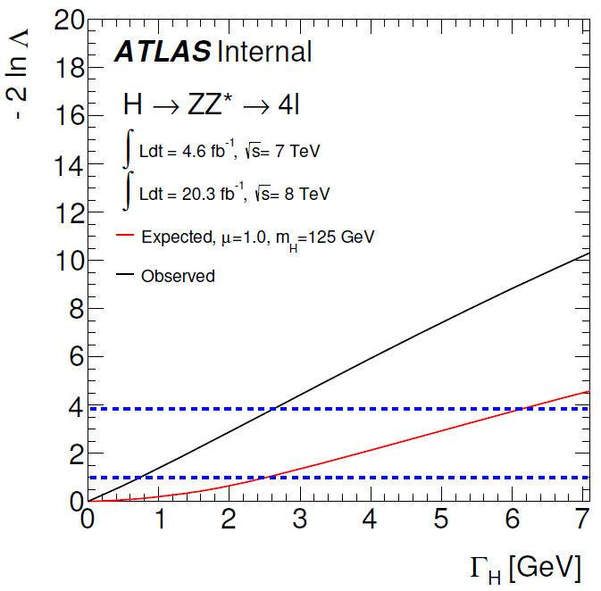
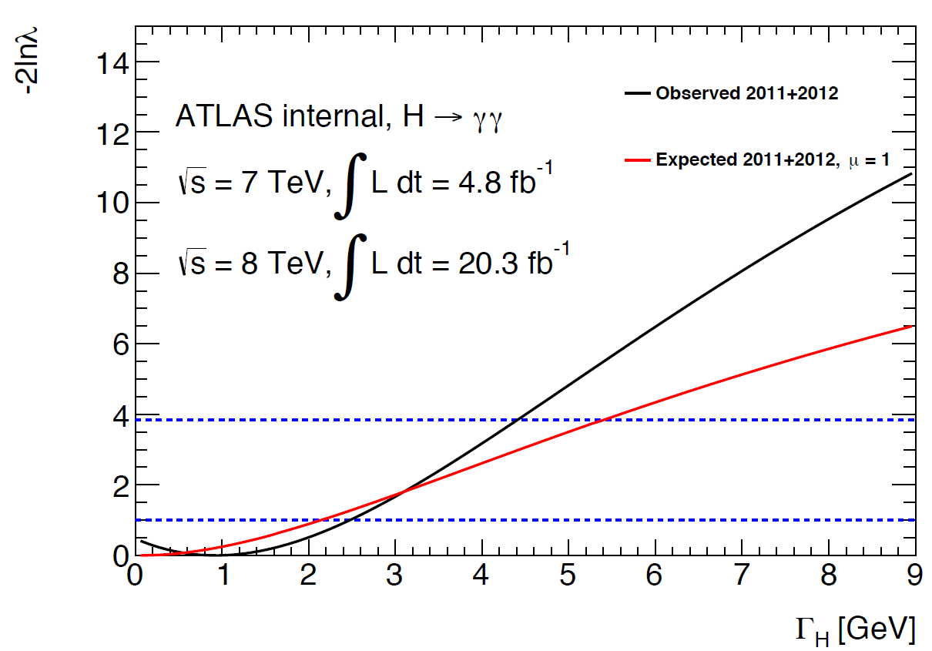
Higgs Width
Using per-event-error method, direct limit on the total width of the Higgs boson LH < 2.6 GeV @ 95% C.L.

Slide 24
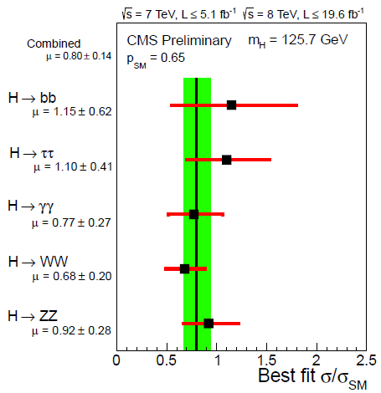
Measurements of Higgs Signal Strength
Signal strength: μ=1.3±0.2(ATLAS)
μ = 0.8 ±0.14 (CMS)
PLB 726 pp.88-119
ATLAS-CONF-2014-009
CMS-HIG-13-005

Slide 25
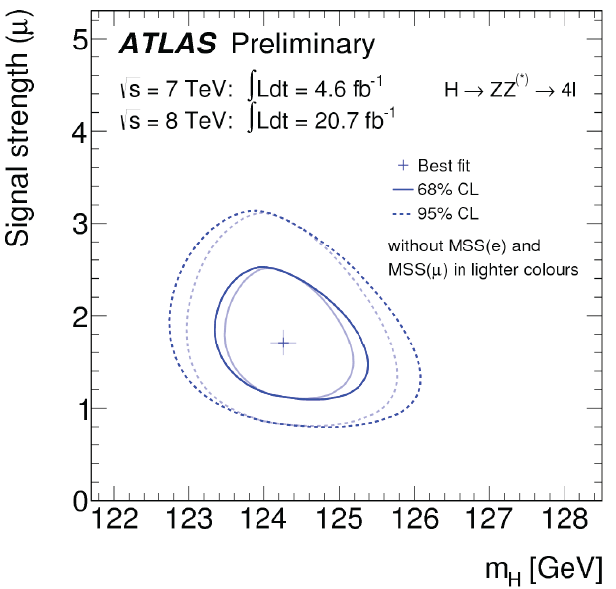
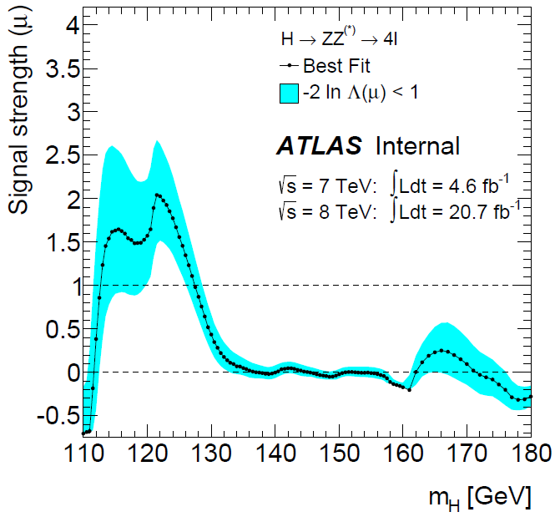
Higgs Mass and Signal Strength
μ = 1.5 ± 0.4 at combined
mass m_{H} = 125.5 GeV

Slide 26
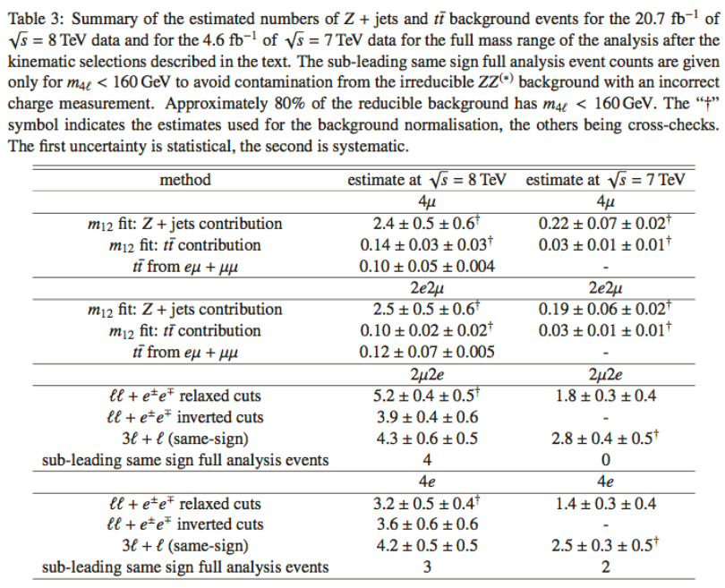
Background Estimation

Slide 27
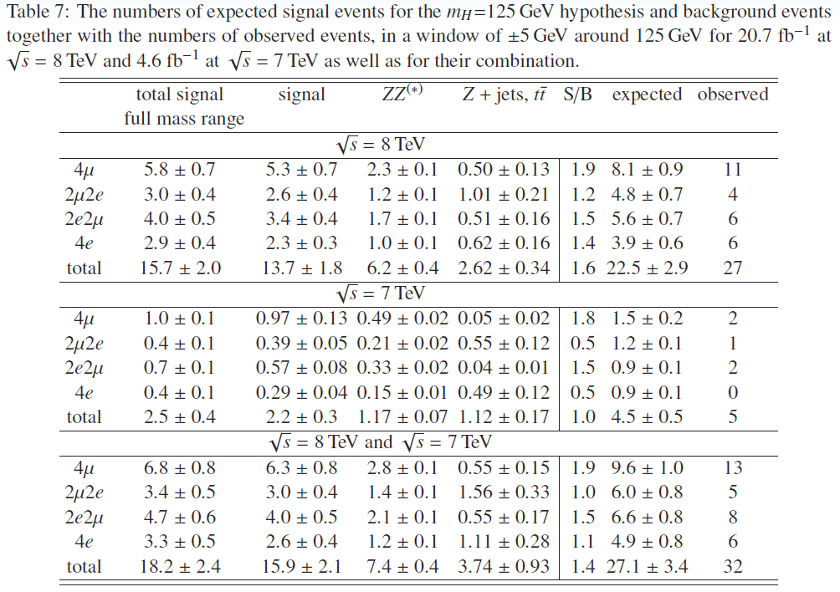
Selected Events

Slide 28
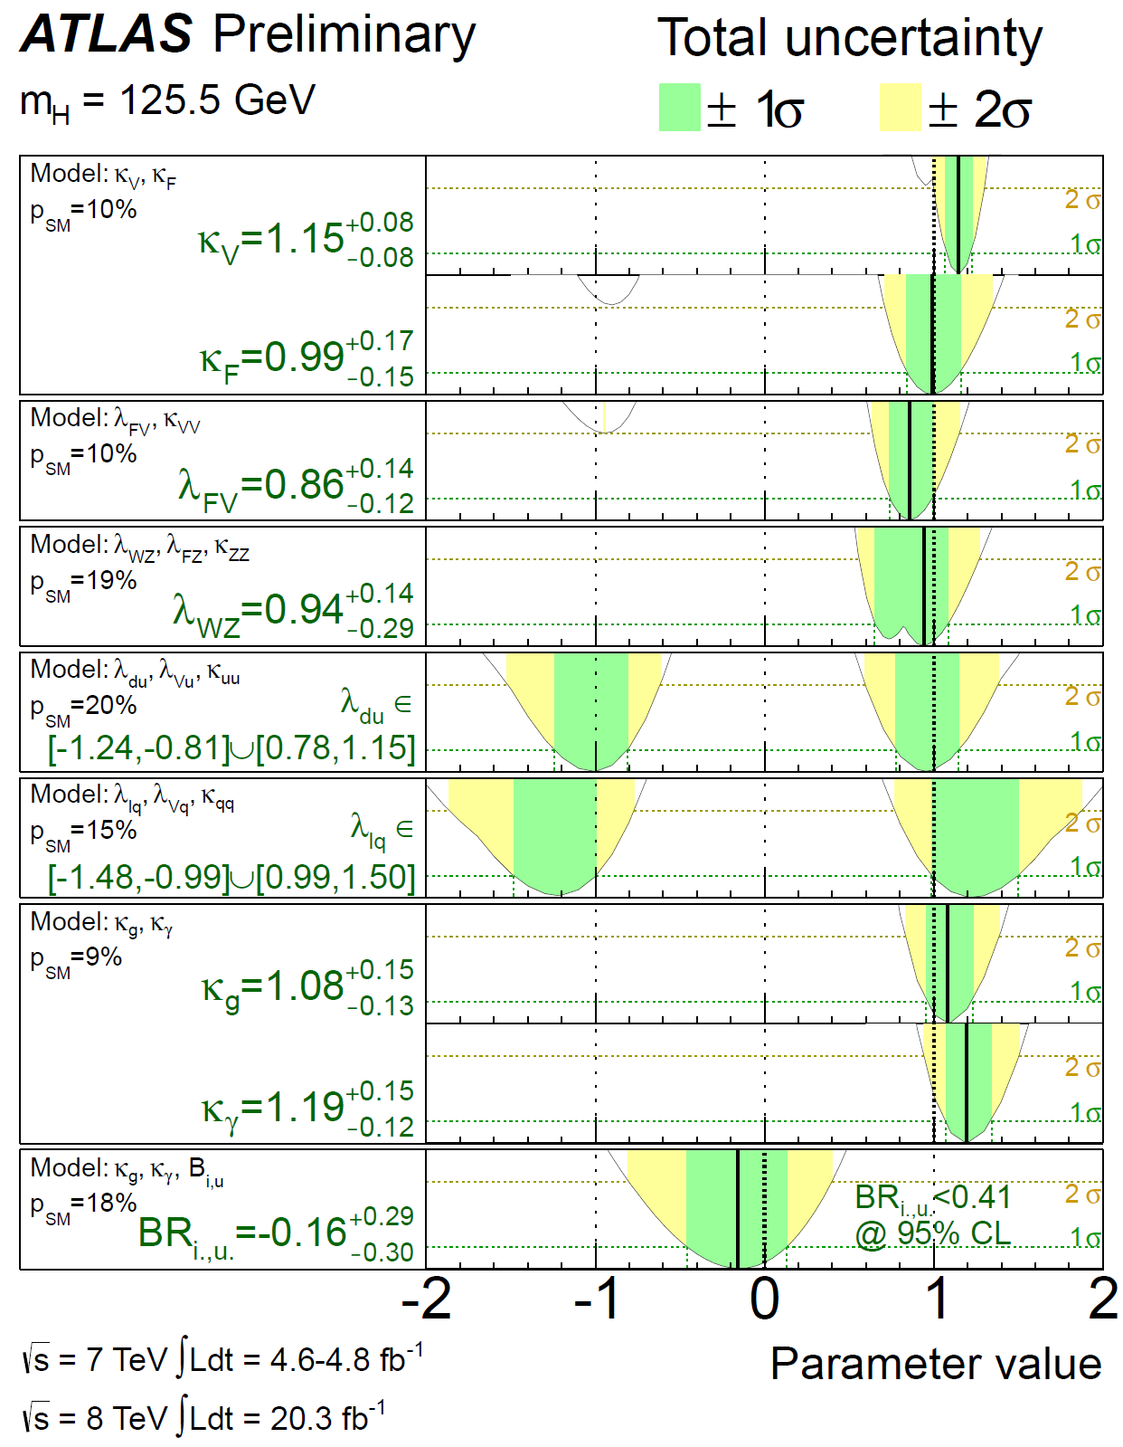
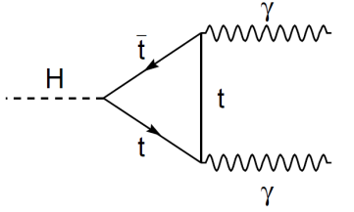
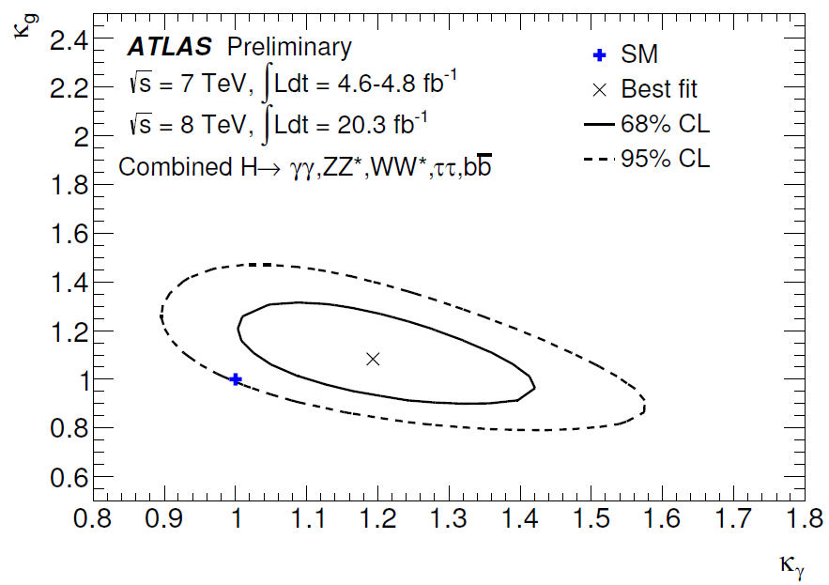
Constraints on BSM
New heavy particles may contribute to loops
Introduce effective κ_{g}, κ_{γ} to allow heavy BSM particles contribute to the loops
Tree-level couplings: κ_{W},κ_{Z,}κ_{t},κ_{b}, κ_{τ} etc set to 1
Absorb all difference into loop couplings
Indirectly fixed normalization of Higgs width
Couplings tested for anomalies w.r.t.
fermion and boson, W/Z & vertex loop
contributions at ±10%-15% precision
3D Compatibility with SM: 18%

Slide 29
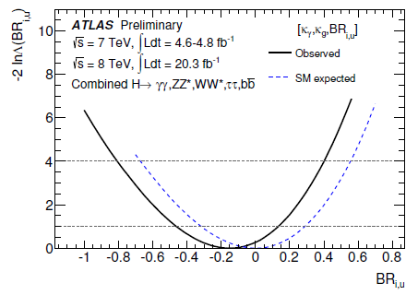
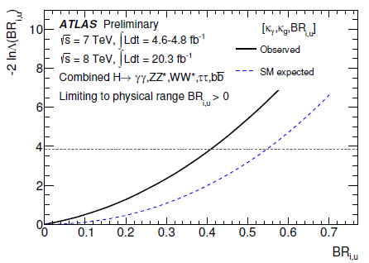
Constraints on BSM Loops
New particles may contribute to loops
Introduce effective κ_{g}, κ_{γ} to allow heavy BSM particles contribute to the loops
Tree-level couplings: κ_{W},κ_{Z,}κ_{t},κ_{b},κ_{τ} set to 1
Absorb all difference into loop couplings
Indirectly fixed normalization of Higgs width

Slide 30
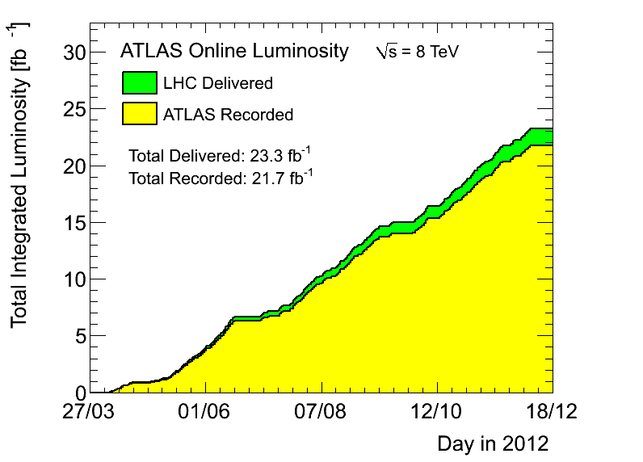
ATLAS Data Samples
7 TeV data samples (2011)
4.6 fb⁻¹ for physics analysis
Peak luminosity 3.6×10³³cm⁻²s⁻¹
8 TeV data samples (2012)
20.7 fb⁻¹ for physics analysis
Peak luminosity 7.7×10³³cm⁻²s⁻¹
Data-taking efficiency: ~95.5%
Significant pileup events
HCP
ICHEP

Slide 31
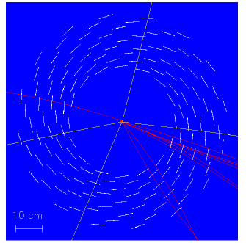
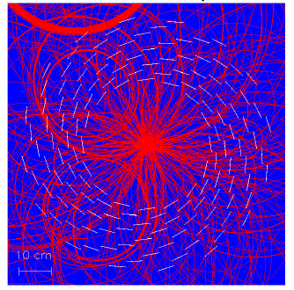
Major Challenge (Large Pileup)
Large pileup events result in big challenge to the detector, reconstruction and particle identification !!!
H→ZZ→4μ
μ
μ
μ
μ

Slide 32
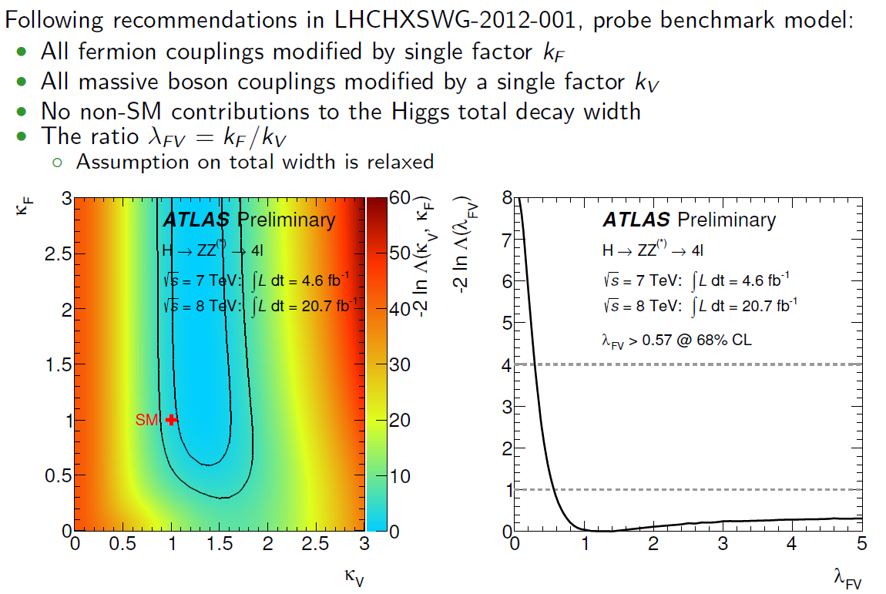
Higgs Couplings

Slide 33
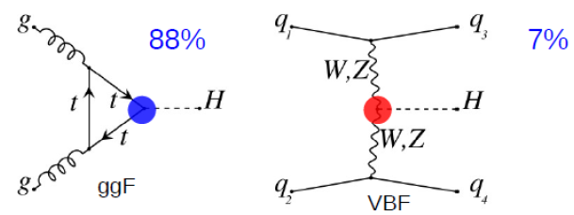
Is it the SM Higgs Boson?
Higgs production (m_{H} = 125 GeV)
Higgs decays
W, Z
f
H
H
W, Z
f
Couplings (new force!)
g_{F} (Yukawa coupling) =√2 x m_{F}/ν
g_{V} (Gauge coupling) = 2m_{V}²/ν
(ν is the vacuum expectation value)
Spin and Parity

Slide 34
Coupling Measurements
Coupling strengths κ_{i} & ratio: κ_{F} =g_{F}/g_{F,SM}, κ_{V} =g_{V}/g_{V,SM}, λ_{ij} = κ_{i} /κ_{j}
Example H → γγ
κ_{g} , κ_{γ}: loop coupling scale factors
κ_{H} is the total Higgs width scale factor
(8)

Slide 35
Spin Analysis with H→ γγ
Polar angle θ* of the photon decay in Collines-Soper frame, along with m_{γγ}
Z_{CS} bisects angle between the momenta of colliding hadrons
CS
data
0⁺
data
2⁺

Slide 36
Spin Analysis With H→ WW*
BDT discriminant
2⁺
0⁺
Observed 2⁺ (qq=100%) exclusion 99.96%
Exclusion (1-CL_{s} ):
Observed 2⁺ (qq = 0%) exclusion 95.2%

Slide 37
H→ZZ*→4l : Spin and CP

Slide 38
ATLAS Trigger

Slide 39
Higgs Production and Decays

Slide 41
Invariant Mass of 4-lepton

Slide 42
MVA Discriminant: Higgs Spin and CP

Slide 43
BR of Z → 4l

Slide 44
Search for High Mass H→ ZZ, WW
ATLAS-CONF-2013-067
Extend the Higgs search to high mass assume SM-like width, and decay to WW/ZZ
WW*→ lνlν
ZZ*→ 4l
ZZ
95% C.L. exclusion of a SM-like heavy Higgs up to ~ 650 GeV

Slide 45
Large Hadron Collider at CERN
ALICE
ATLAS
CERN
CMS
LHCb
LHC: 27 km, the world’s largest proton-proton collider (7-14 TeV)

Slide 46
The ATLAS Detector
DAQ: 40 MHz
46 x 25 x 25 m, 7000 tons
~3000 researchers

Slide 47
Particle Detection
Different particles have different signatures in detectors
Muon Spectrometer: muon identification and momentum measurement
Hadronic calorimeter: Measurement of jets and missing energy
Electromagnetic calo: e/γ identification and energy measurement
Tracking system: Charged particle momentum, vertexing

Slide 48
Higgs Width (CMS)
https://cds.cern.ch/record/1670066/files/HIG-14-002-pas.pdf

Slide 49
Higgs Width (CMS)
https://cds.cern.ch/record/1670066/files/HIG-14-002-pas.pdf

