Slide 1
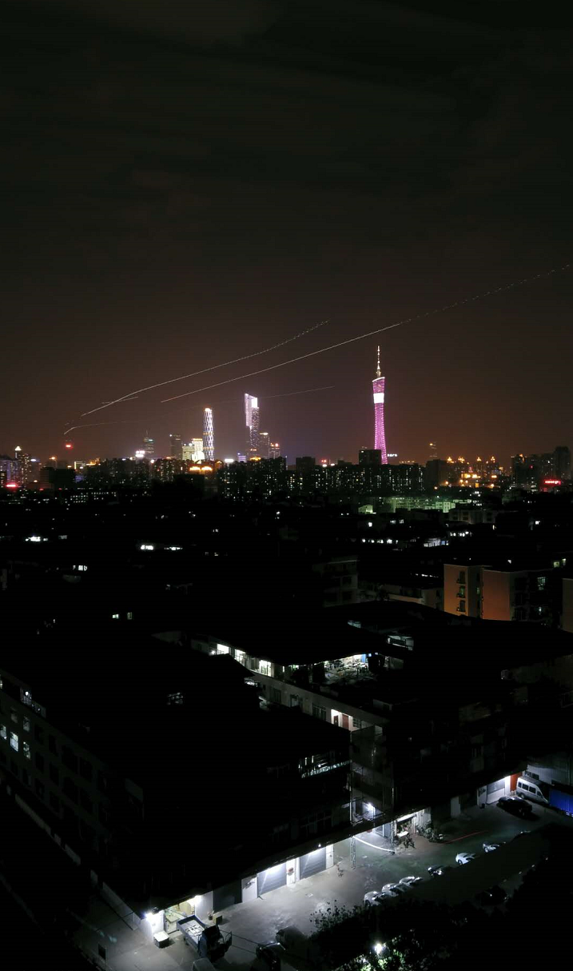
Slightly reheat a hidden gluonic sector
Based on arxiv: days later, by ZK
Zhaofeng Kang (康昭峰), Huazhong Science and Technology (HUST), 25/01/2019，中山大学

Slide 2
Outline
Dark glueball dark matter from dark $SU(N_{d})$
an attractive non-WIMP DM candidate
Suffering from the problem of overproduction
Our solution: reheat the dark sector slightly
We introduce higher dimensional operators linking
SM & dark gluon sector
They could reheat the dark gluonic sector slightly
At the same time leads to a decaying DGB
Conclusions

Slide 3
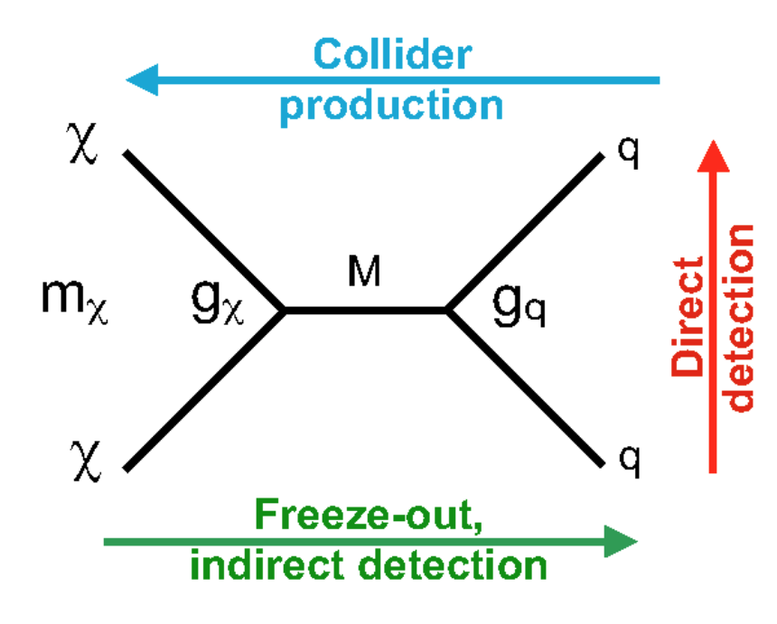
Dark glueball (DGB) dark matter
WIMP dark matter (DM): miracle & missing
DM: savagely breed the next breakthroughs of particle physics
WIMP miracle to understand the 25% DM budget
in freeze-out dynamics, the weak scale particle (~ 100 GeV) with weak interaction strength (~ 0.1) leads to right DM annihilation rate <σv>~1pb
Hard & long & many DM searches, to find the expensive inequality:
$$\frac{\left\langle σv\right\rangle }{σ_{SI}}≳{10}^{9}‼!$$

Slide 4
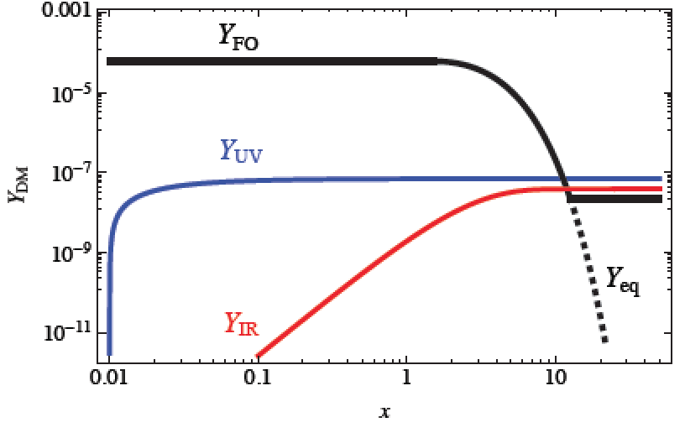
Dark glueball (DGB) dark matter
Is the WIMP paradigm misleading?
Bird’s view over FIMP
Freeze-out is not the only way to get correct relic density:
Oscillation & keV scale right-handed neutrino
Misalignment & axion
Freeze-in & FIMP (feebly interacting massive particle)
Never in thermal with the SM bath
Gradually building relic
Classified into two types
IR freeze-in: via $d≤4$ operators
UV freeze-in: via $d>4$ operators, whose
rate is greatly enhanced at high $T$
J. McDonald, PRL, 2002; L.J.Hall, etc., JHEP, 2010
Even much earlier in SUSY

Slide 5
Dark glueball (DGB) dark matter
DGB from pure-gluon hidden valley
Non-Abelian gauge groups are frequently used in new physics
Dark matter
Origin of baryon asymmetry
Flavor puzzle
In particular, string theory
DGB as an attractive non-WIMP DM
Neutral & stable & No signals in the minimal setup
Dynamical origin of DM mass
Less parameters: confining scale $Λ_{d}$+ $N_{d}$+relic density

Slide 6
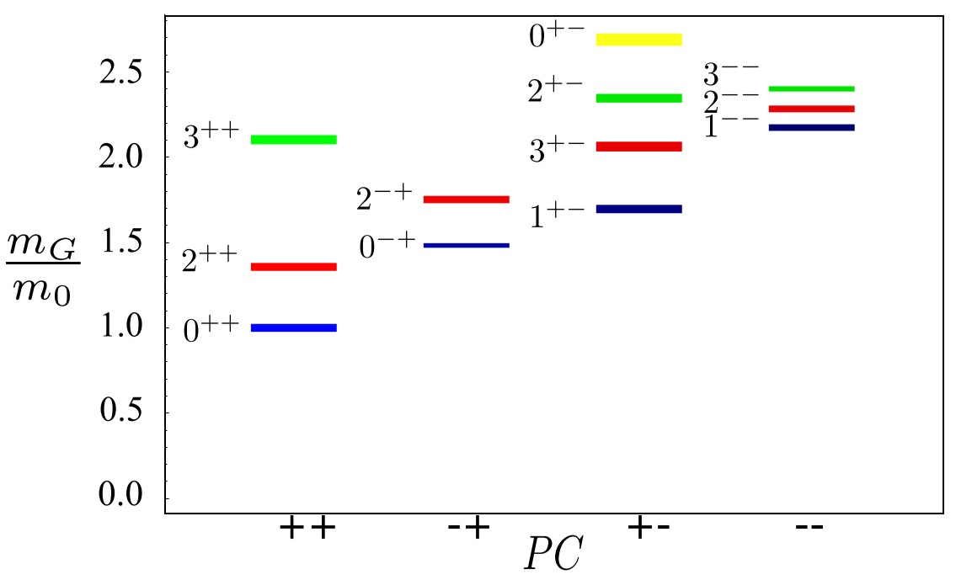
Dark glueball (DGB) dark matter
DGBs spectra from $SU(3)$ lattice
C. J. Morningstar and M. J. Peardon, PRD (1999)
A tower of DGBs classified by $J^{CP}$
The lowest lying is a CP-even scalar $0^{++}$, having mass
The others are tabled below, all of them are stable
$α≈$7, universal relation given $N_{d}≫1$
Some of them are stable even in the presence of strong SM-DGB link by virtue of the $C$-odd number

Slide 7
Dark glueball (DGB) dark matter
Effective theory for the lowest lying DGB $0^{++}≡s$
Construction based on large-$N$ & NDA analysis
large-$N$ implies weak coupling
NDA analysis implies strong coupling, adding $4π$ factors
$c_{i}\sim 𝒪(1)$
Needs confirmation from non-pertubative QCD experts
The key term $s^{4}$, giving rise to DM self-scattering thus the constraint
The important term $s^{5}$, relating to DGB relic density (see next page)

Slide 8
Dark glueball (DGB) dark matter
Relic density: a problem
E. D. Carlson, M. E. Machacek, and L. J. Hall, APJ (1992).
DGB freezes-out via $sss→$ss
The dark gluonic sector is putative in thermal equilibrium
Cross section estimation of the annihilation $sss→$ss
This annihilation freezes-out at $𝒯_{d}≲Λ_{d}$
Using entropy conservation, number density is estimated to be
$𝒯_{d}=Λ_{d}$ in the limit of $c_{5}→0$
Later, a similar result will be obtained using energy conservation
$𝒯_{d}\sim Λ_{d}≳100$ MeV
Thus $ξ_{T}=\frac{𝓣_{d}}{T}≪1$ to suppress relic density

Slide 9
Dark glueball (DGB) dark matter
DGB & SM bridged by higher dimensional operators
Two representative: $d=6$ Higgs portal & $d=$8 vector boson portal
they open decay channels for DGB
The subtle to deal with non-perturbative matrix in calculating decay:
Decays at $d=6$ （$s→VV$ ）
Decays at$d=8$（$s→VV$ ）, much more significantly suppressed

Slide 10
Slightly reheat the hidden dark gluons
Dark glue energy density via UV freeze-in
A brief history of time
Inflation ends & an absolutely quite universe @ $t_{end}$
Oscillation & matter dominance
Decay & prethermalization:
Radiation thermalization, building a SM bath @ $t_{th}\sim ?$
Decays away & radiation dominance @ $t_{re}\sim \sqrt{Γ_{φ}M_{Pl}}$
$$\text{the} \text{inflation} \text{field} φ \text{oscillat}\text{es} \text{around} \text{the} \text{bottom}\text{, }\text{behaving} \text{as} \text{nonrelativistic} \text{matter}$$
$\text{Inflaton}\text{ (}\text{perturbatively}\text{) }\text{decays} \text{into} \text{SM} \text{particles} {\sim Γ}_{φ}$
$\text{they}$ have not reached thermal equilibrium yet
(nearly) virgin land
WIMP land: extensively plowed

Slide 11
Slightly reheat the hidden dark gluons
Dark glue energy density via UV freeze-in
K. Harigaya and K. Mukaida, JHEP (2014).
A closer but look at thermalization
Slow inflaton decay setup: $Γ_{φ}\sim km_{φ}^{2}/M_{Pl}$ with $k≲1$
Very hard primary radiation @
inflaton mass$m_{φ}$ from inflaton decay
Colinear soft gluons emission plays a very important to soften the hard modes
Thermalization time scale
$k≫1⇒t_{re}≫m_{φ}$ $⇒$complicated thermal effects

Slide 12
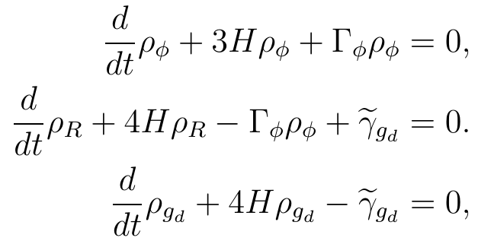
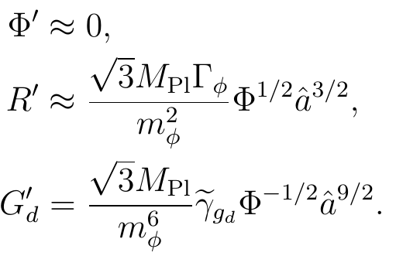
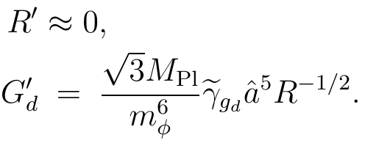
Slightly reheat the hidden dark gluons
Dark glue energy density via UV freeze-in
energy transfers in the inflaton-SM radiation-dark gluon system
BEs for energy densities & no-backreaction approximations
Analytical solutions to inflaton matter
in the decoupling limits
Analytical solutions to radiation
BEs in radiation dominance
BEs during reheating

Slide 13
Slightly reheat the hidden dark gluons
Dark glue energy density via UV freeze-in
energy transfers in the inflaton-SM radiation-dark gluon system
Collision terms in phases I, II & III
Phase I: prethermal phase
Phase II: thermal during reheating
Similar in phase III

Slide 14
Slightly reheat the hidden dark gluons
Temperature of dark gluons
Dark gluon energy density
Obtained by direct integrating over $a$
Estimate dark gluon temperature: some working assumptions
Energy transfer between dark and visible sectors effectively shuts down @ $t_{re}$
Dark gluons thermalizes before$t_{re}$
Dark gluon temperature
Needs further specific study

Slide 15
Slightly reheat the hidden dark gluons
Prethermal VS. thermal UV freeze-in
Higgs portal $d=6$
Difficult prethermal production domination:
${10}^{13}GeV{(1/k)}^{\frac{1}{16}}{(α/0.01)}^{2}{≪m}_{φ}≲convex limit\sim {10}^{15}GeV$
Vector boson portal $d=8$
Easy prethermal production domination in Plank suppressed decay
${10}^{13}GeV{(k/1.0)}^{\frac{11}{16}}{(α/0.01)}^{2}{≪m}_{φ}≲{10}^{15}GeV$

Slide 16
Slightly reheat the hidden dark gluons
DGB relic density
From dark gluons to dark glueballs
Dark confining phase transition @ $𝒯\sim Λ_{d}$, and dark gluon confines into dark glueballs
Dark glueballs soon become nonrelativistic
Assuming the dark gluons mainly transform into the ground state
Dark glueball energy density from energy conservations
DGB relic density

Slide 17
Slightly reheat the hidden dark gluons
Detecable in the cosmic rays?
$d=6$Higgs portal
Displace the parameter space most accessible
FERMI-LAT gamma ray data is sensitive to $τ(s→VV)\sim {10}^{28}s$
Hopeful for a relatively large $r_{φ}=m_{φ}$/ $M<<1$, for the sake of no on-shell mediator production

Slide 18
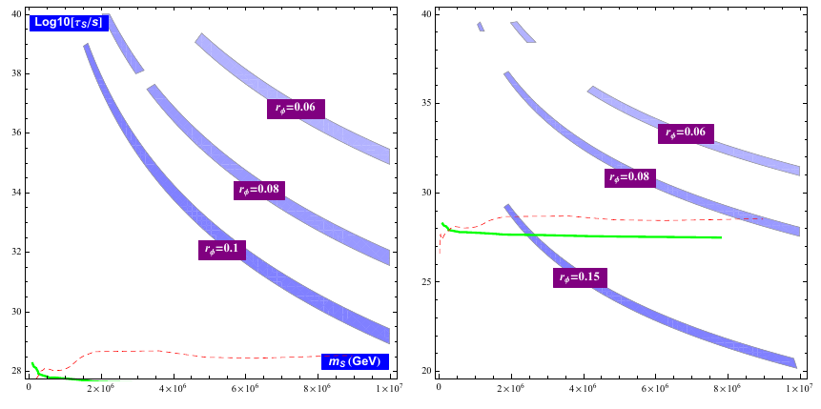
Slightly reheat the hidden dark gluons
Detecable in the cosmic rays?
$d=8$vector boson portal
Only PeV scale DGB is accessible because of ${Γ_{s}\sim \left(m_{s}/M_{8}\right)}^{9}$
Constraint from FERMI-LAT gamma ray data & IceCube neutrino data
Sensitive to $τ(s→VV)\sim {10}^{28}s$
PeV events in IceCube?

Slide 19
Conclusions
DGB from the dark Yang-Mills sector is an attractive non-WIMP DM candidate
But it has the overproduction problem, requiring a much cooler dark sector at the high temperature
We propose a solution by introducing higher dimensional operator to bridge the SM and dark gluonic sector, which naturally reheat the dark sector slightly
At the same time they lead to a decaying & detectable DGB
Thanks for your attention~~~~

