Slide 1
Does current data imply a Baroque neutrino sector?
廖佳军
中山大学
Based on work in
JL and Marfatia, Phys. Rev. Lett. 117, 071802 (2016)
[arXiv: 1602.08766 ]
JL, Marfatia and Whisnant, Phys. Rev. D 99, 015016 (2019) [arXiv: 1810.01000 ]
High Energy Conference, SYSU, Guangzhou, 1/21/2019

Slide 2
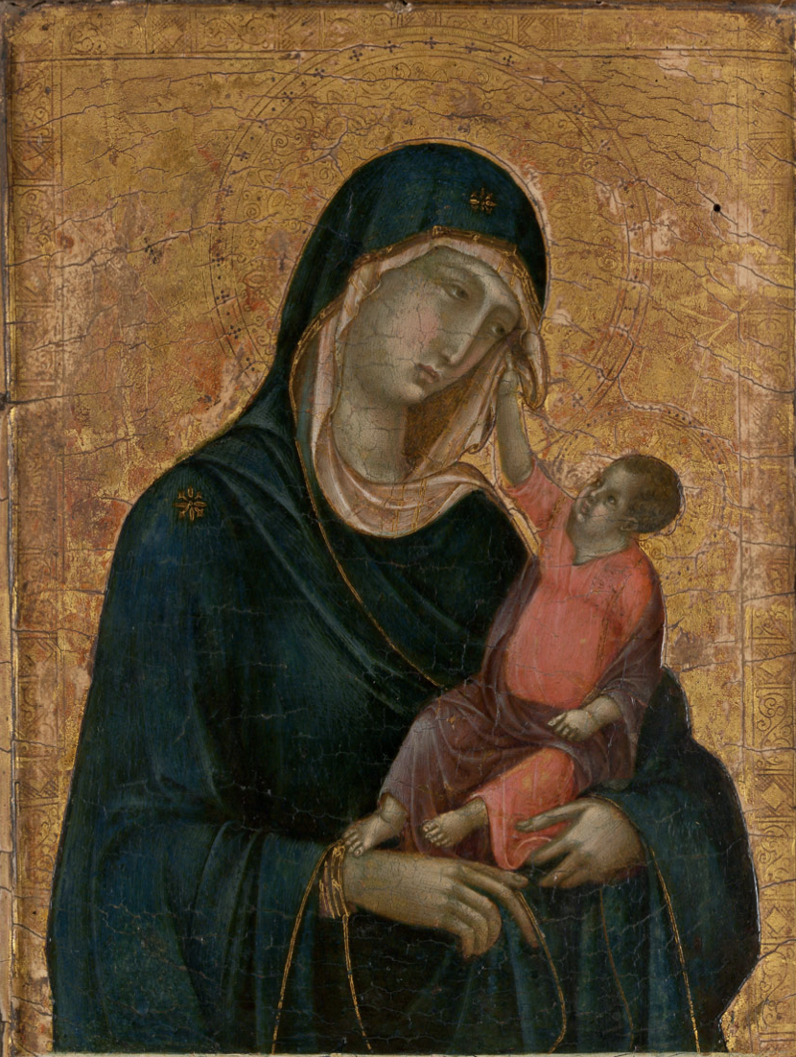
A Brief History of Western Art
14th century
16th century
18th century
Classical
Medieval
Renaissance
Baroque
/Rococo
Neoclassism
Impressionism
Madonna and Child
By Duccio di Buoninsegna
Mona Lisa
By Leonardo da Vinci
Madame de Pompadour
By Francois Boucher
Woman with a Parasol
By Claude Monet

Slide 3
Outline
Introduction
Tensions in light sterile neutrino searches
3+1 with NSI
Summary

Slide 4
Outline
Introduction
Tensions in light sterile neutrino searches
3+1 with NSI
Summary

Slide 5
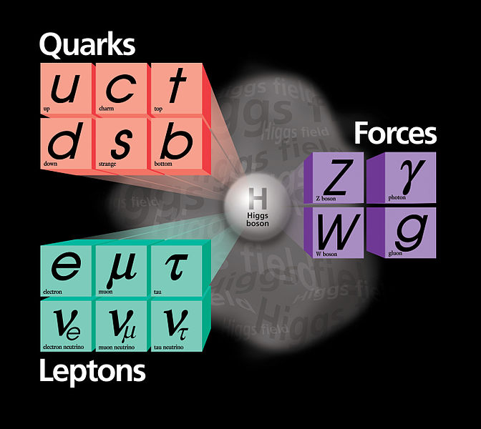
A Classical picture: SM
Neutrinos:
Massless, Neutral, Weak interaction

Slide 6
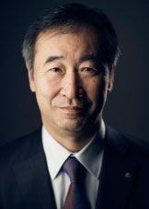
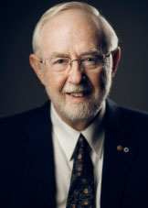
Renaissance: Neutrino Oscillations
$$ν_{e}$$
$$ν_{μ}$$
$$ν_{τ}$$
Kajita@Super-K
McDonald@SNO
won Nobel Prize in 2015
Flavor Eigenstate
Mass Eigenstate
$$α=e,μ,τ$$
$$i=1,2,3$$
SK, K2K, MINOS…
Daya Bay, RENO, T2K…
SK, SNO, KamLAND…
0$νββ$
$$θ_{12},θ_{13}, {δm}_{21}^{2},θ_{23},{δm}_{31}^{2},δ$$

Slide 7
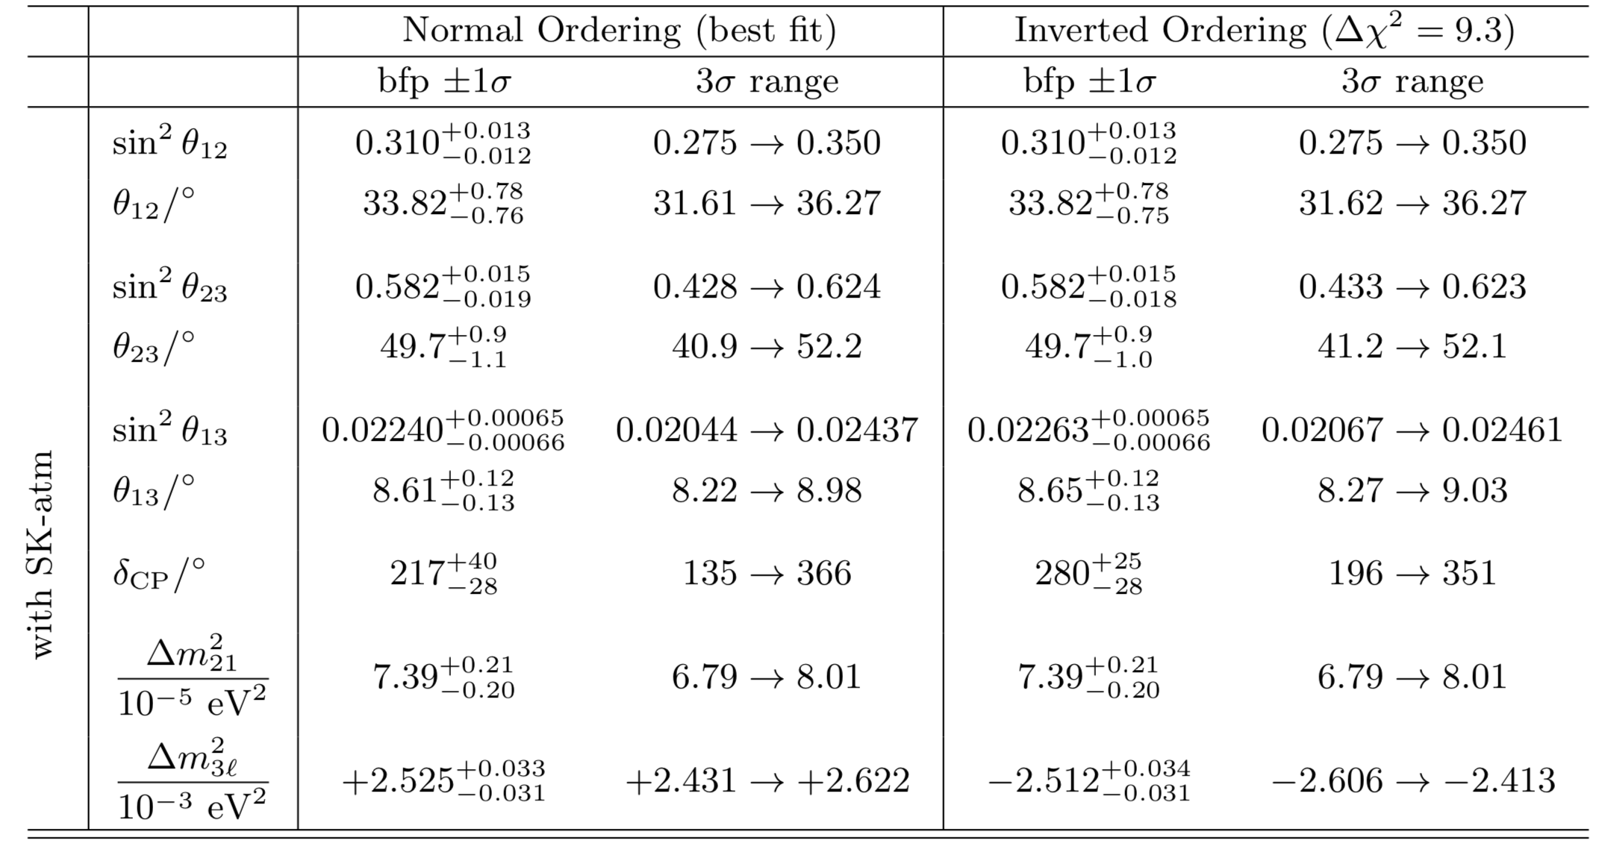
Oscillation Parameters
[Ivan Esteban et al. 1811.05487]
CP violation
Mass Ordering, ${δm}_{31}^{2}$>0 or ${δm}_{31}^{2}$<0
$θ_{23}$ Octant, $θ_{23}$> ${45}^{°}$ or ${θ_{23}\text{<}45}^{°}$
Primary goals:
Next-generation oscillation experiments: JUNO, DUNE, T2HK, MOMENT,…

Slide 8
Baroque neutrinos
Sterile neutrinos
Nonstandard interactions
Lorentz and CPT violation
Non-unitary mixing
Neutrino decay
……
“All things are possible until they are proved impossible - and even the impossible may only be so, as of now.”
Pearl S. Buck (赛珍珠)

Slide 9
Outline
Introduction
Tensions in light sterile neutrino searches
3+1 with NSI
Summary

Slide 10
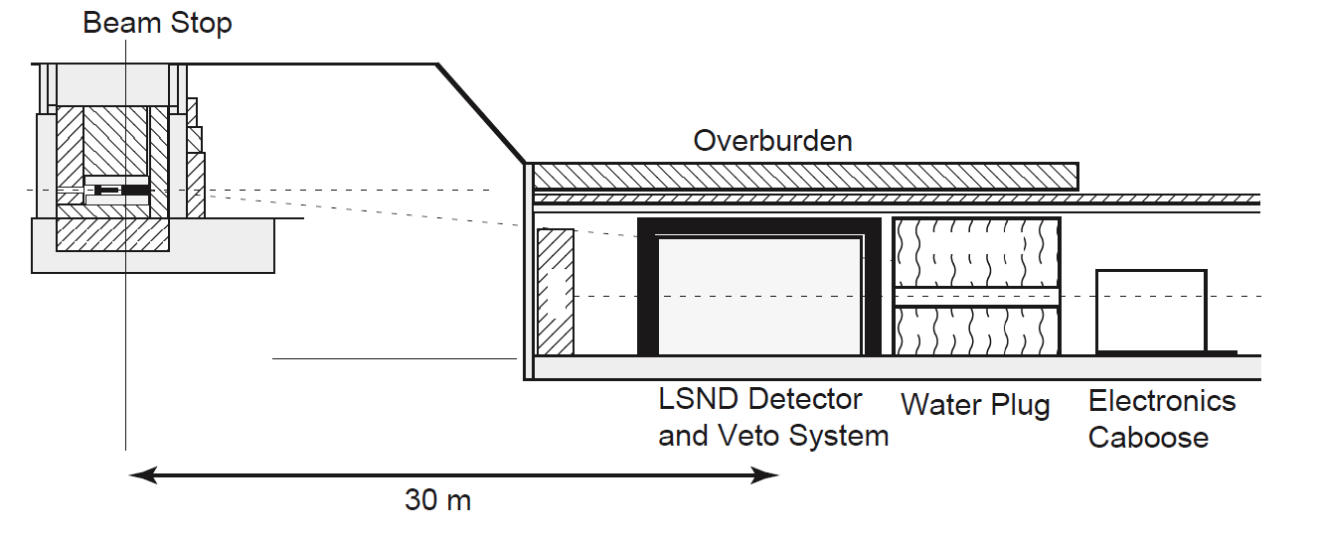
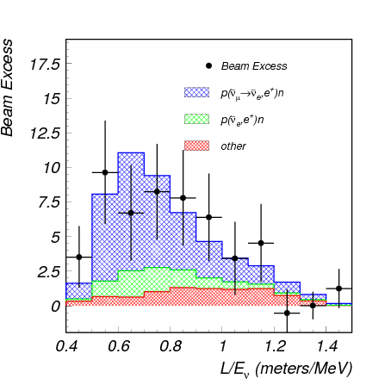
LSND
Decay at Rest
$${\overline{ν}}_{e}+p→n+e^{+}$$
$P({\overline{ν}}_{μ}→{\overline{ν}}_{e}$) $≈\sin^{2}2θ_{μe}\sin^{2}\left(\frac{1.27δ{m_{41}}^{2}L}{4E}\right)$
$3.3σ$ Excess
$L\sim 30$m,
$\left\langle E\right\rangle \sim 40 MeV,$
$$L/E\sim 1 km/GeV$$
$${δm}_{41}^{2}\sim 1 {eV}^{2}$$
[PRD 64, 112007 (2001)]

Slide 11
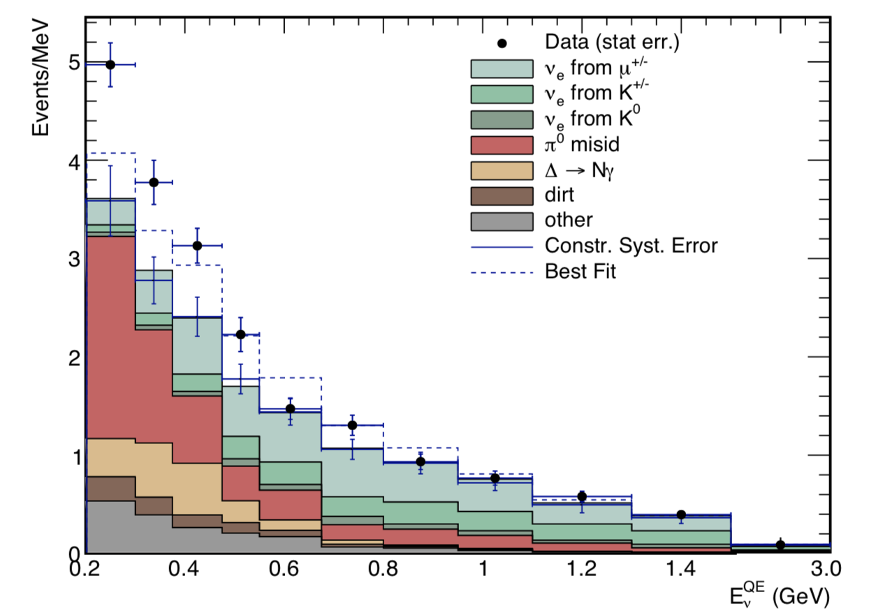
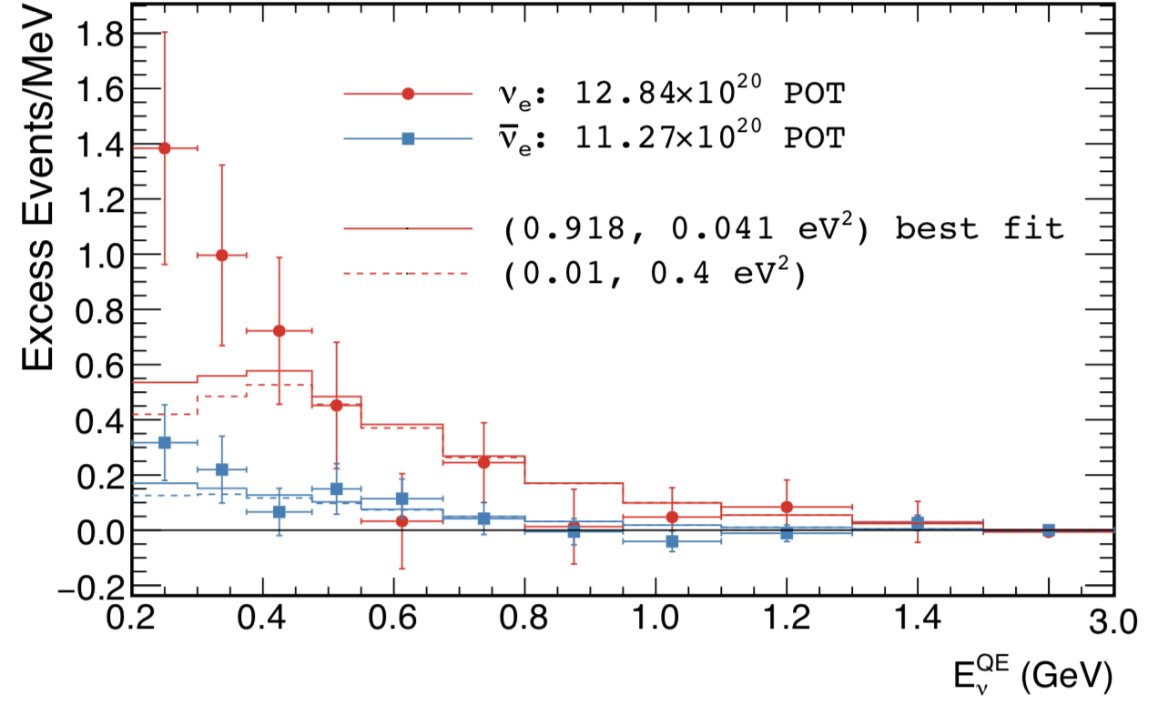
MiniBooNE
Purpose: Check LSND signal
$L\sim 500$m,
$\left\langle E\right\rangle \sim 800 MeV,$
$$L/E\sim 1 km/GeV$$
${\overline{ν}}_{μ}→{\overline{ν}}_{e}$,
$$ν_{μ}→ν_{e}$$
A total excess of 460.5$±$95.8 events (4.8$σ$)
Consistent with LSND
LSND+MB combined has
6.1 𝜎 significance
Caveat: background mismodeling
[PRL 121, 221801 (2018)]

Slide 12
Appearance vs Disappearance
$$ν_{s}$$
$$U=\left(\begin{matrix}\begin{matrix}U_{e1} & U_{e2} \\ U_{μ1} & U_{μ2}\end{matrix} & \begin{matrix}U_{e3} & U_{e4} \\ U_{μ3} & U_{μ4}\end{matrix} \\ \begin{matrix}U_{τ1} & U_{τ2} \\ U_{s1} & U_{s2}\end{matrix} & \begin{matrix}U_{τ3} & U_{τ4} \\ U_{s3} & U_{s4}\end{matrix}\end{matrix}\right)$$
$${\sim θ}_{14}$$
mass
3+1
$${\sim θ}_{24}$$
active
$ν_{μ}\text{(}{\overline{ν}}_{μ}\text{)}→ν_{e}$(${\overline{ν}}_{e}$) appearance experiments
$$\sin^{2}2θ_{μe}=4{\left|U_{e4}\right|}^{2}{\left|U_{μ4}\right|}^{2}≈\frac{1}{4}\sin^{2}2θ_{ee}\sin^{2}2θ_{μμ}$$
$ν_{e}$(${\overline{ν}}_{e}$) disappearance experiments
$ν_{μ}$(${\overline{ν}}_{μ}$) disappearance experiments
$$\sin^{2}2θ_{ee}=4{\left|U_{e4}\right|}^{2}(1−{\left|U_{e4}\right|}^{2})≈4{\left|U_{e4}\right|}^{2}$$
$$\sin^{2}2θ_{μμ}=4{\left|U_{μ4}\right|}^{2}(1−{\left|U_{μ4}\right|}^{2})≈4{\left|U_{μ4}\right|}^{2}$$
Upper bounds on $\sin^{2}2θ_{ee}$ and $\sin^{2}2θ_{μμ}$ can be used to constrain $\sin^{2}2θ_{μe}$
[Okada, Yasuda, IJMPA 12 (1997) 3669-3694]
[Bilenky, Giunti, Grimus, EPJC 1 (1998) 247]

Slide 13
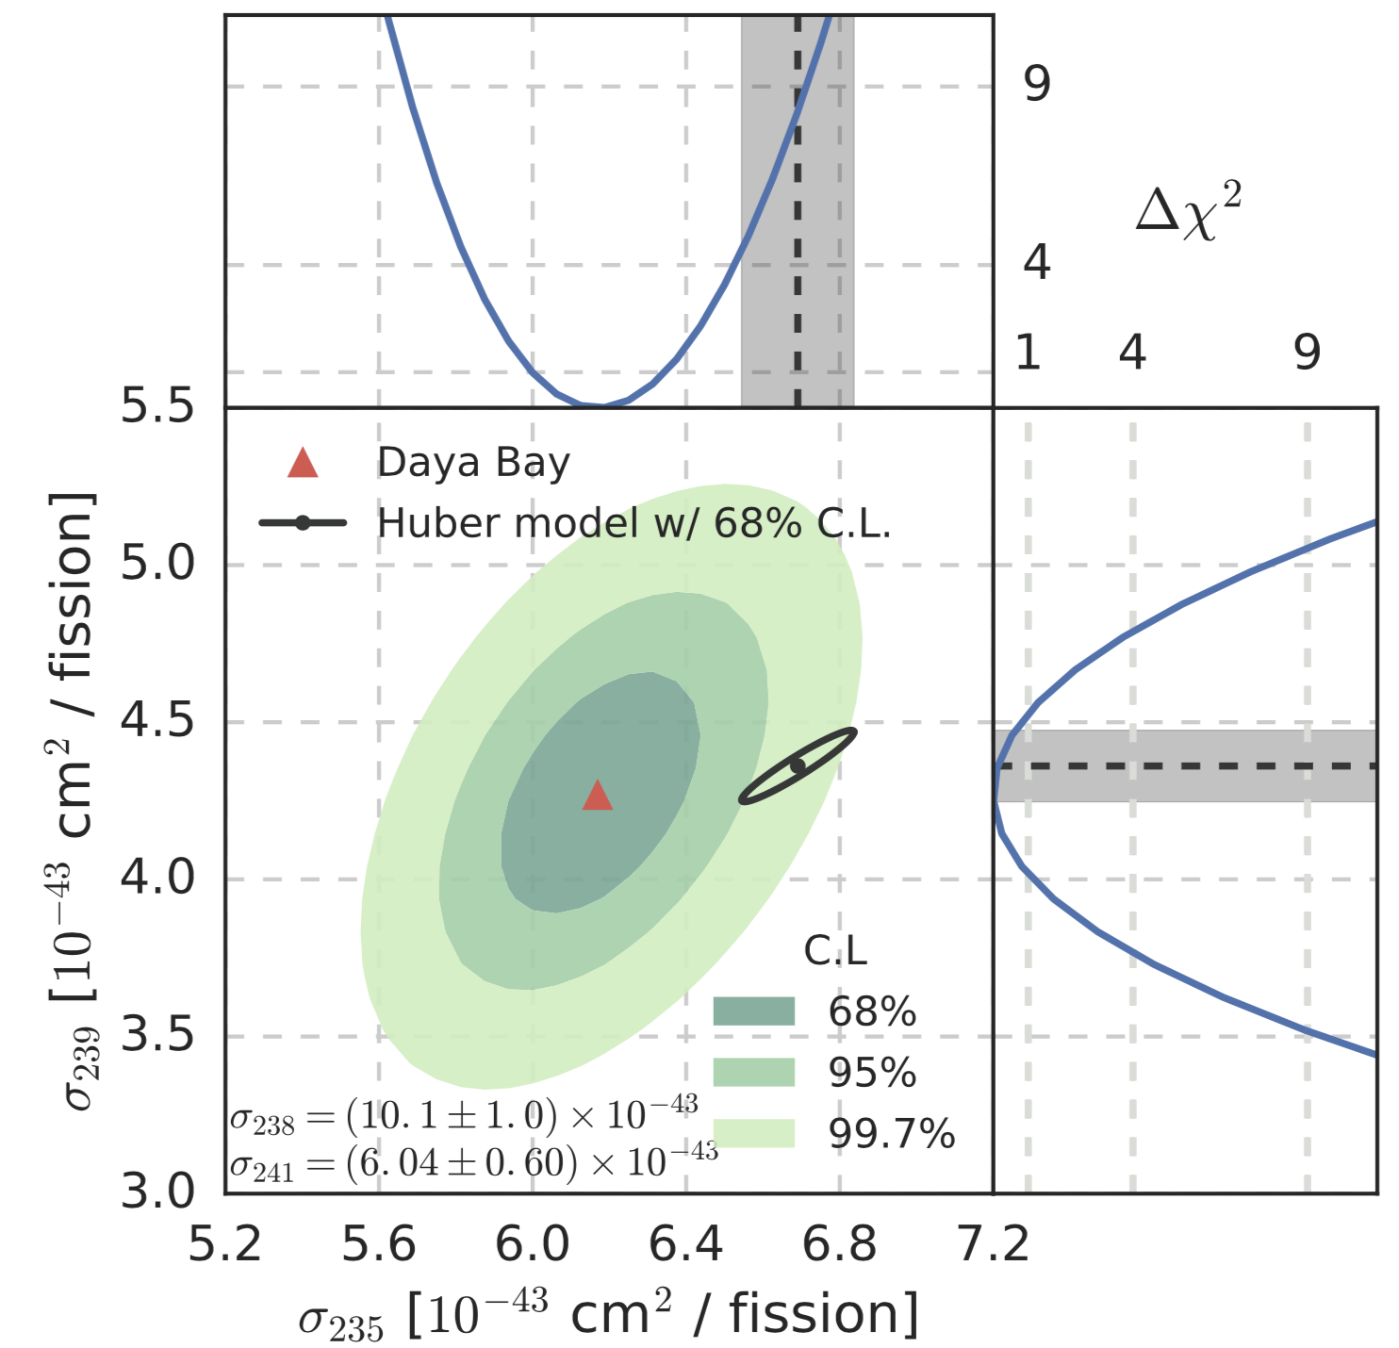
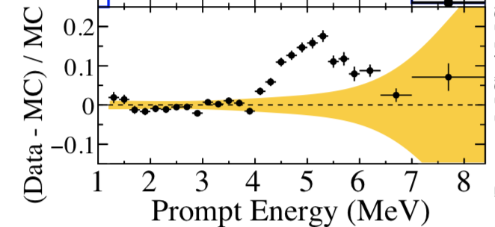
$$ν_{e}\text{(}{\overline{ν}}_{e}\text{) }\text{disappearance}$$
Reactor antineutrino anomaly ✘
flux calculation has been called into question
(“5 MeV bump”, ${}_{}^{235}U$ and ${}_{}^{239}{Pu}$IBD yield from Daya Bay)
Gallium neutrino anomaly ✘
detector efficiency is unknown
[RENO, Phys. Rev. Lett. 116, 211801 (2016)]
[Daya Bay, Phys. Rev. Lett. 118, 251801 (2017)]
[Gariazzo et.al., Phys.Lett. B782, 13 (2018) ]

Slide 14
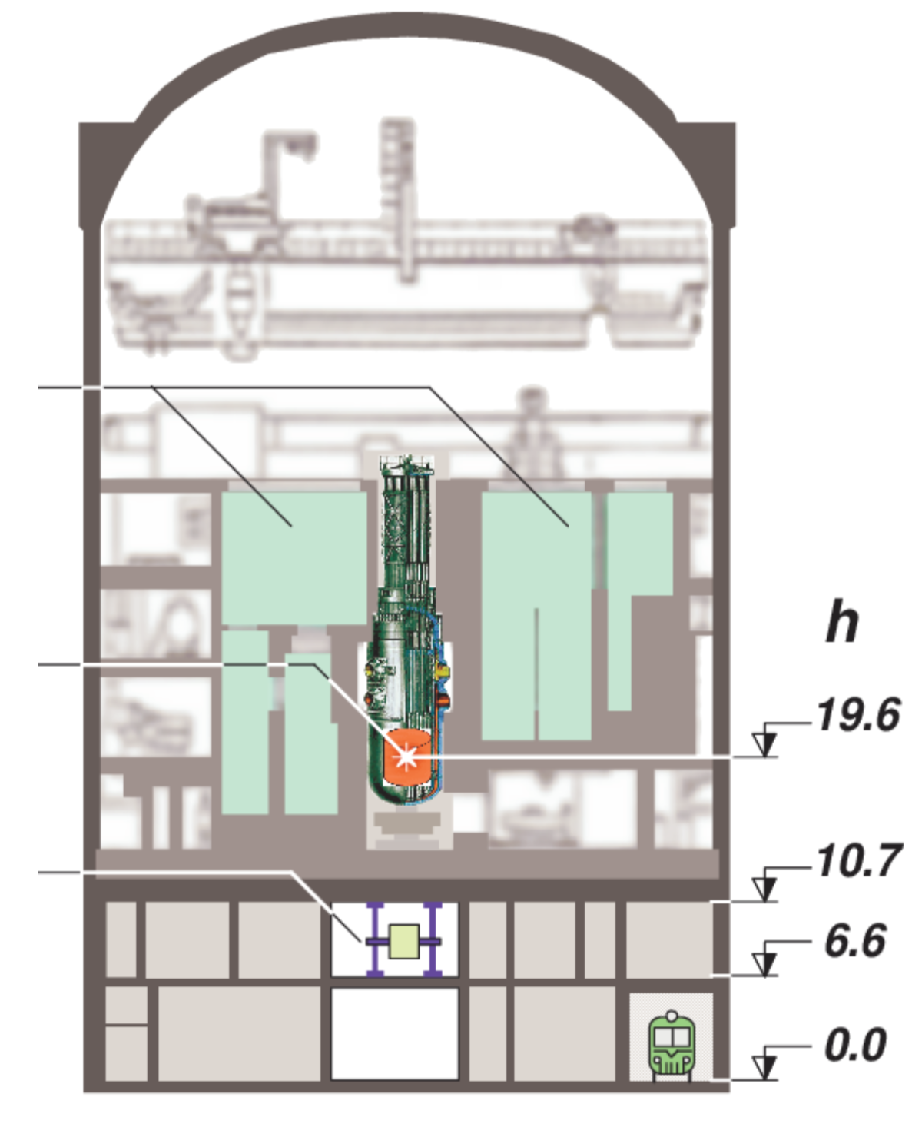
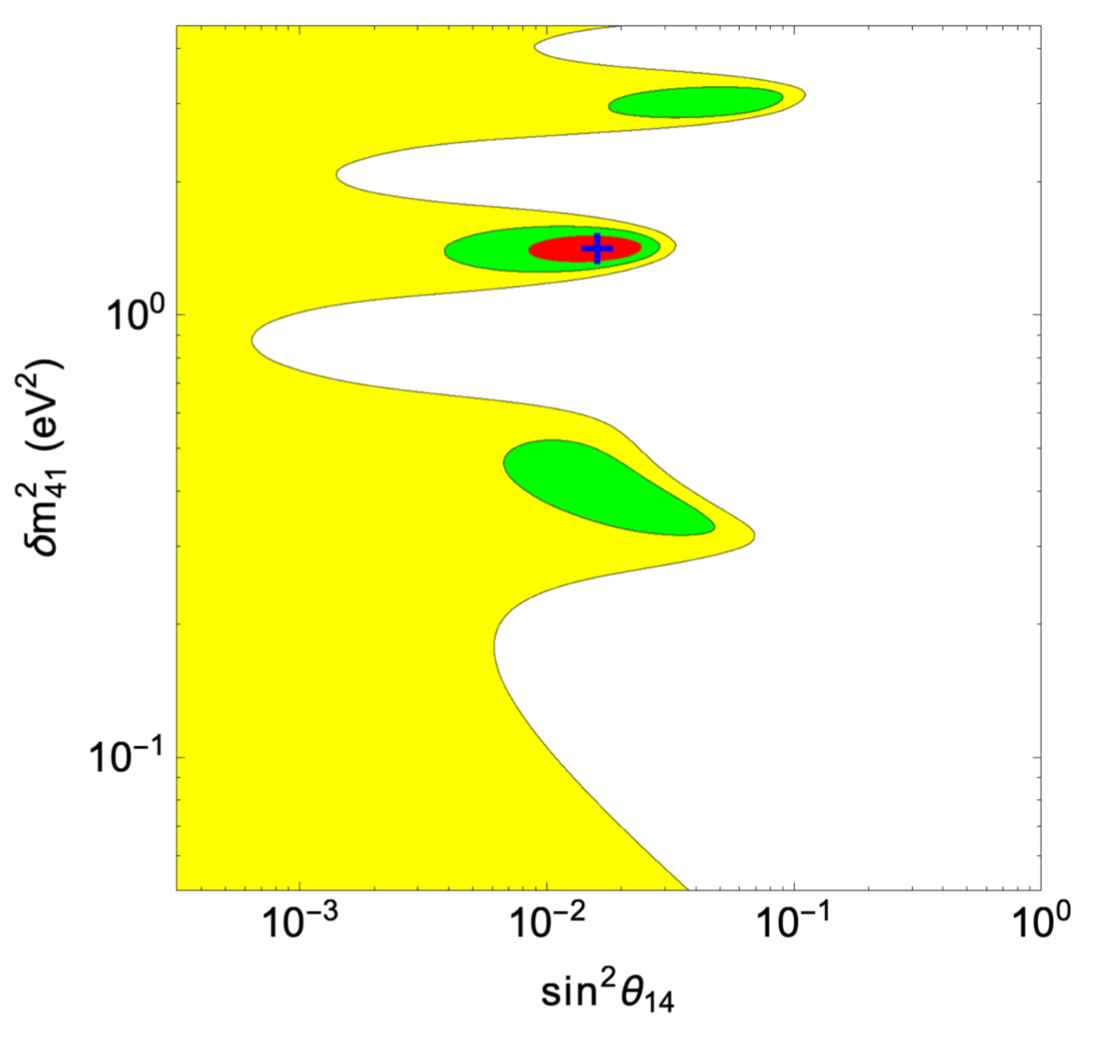
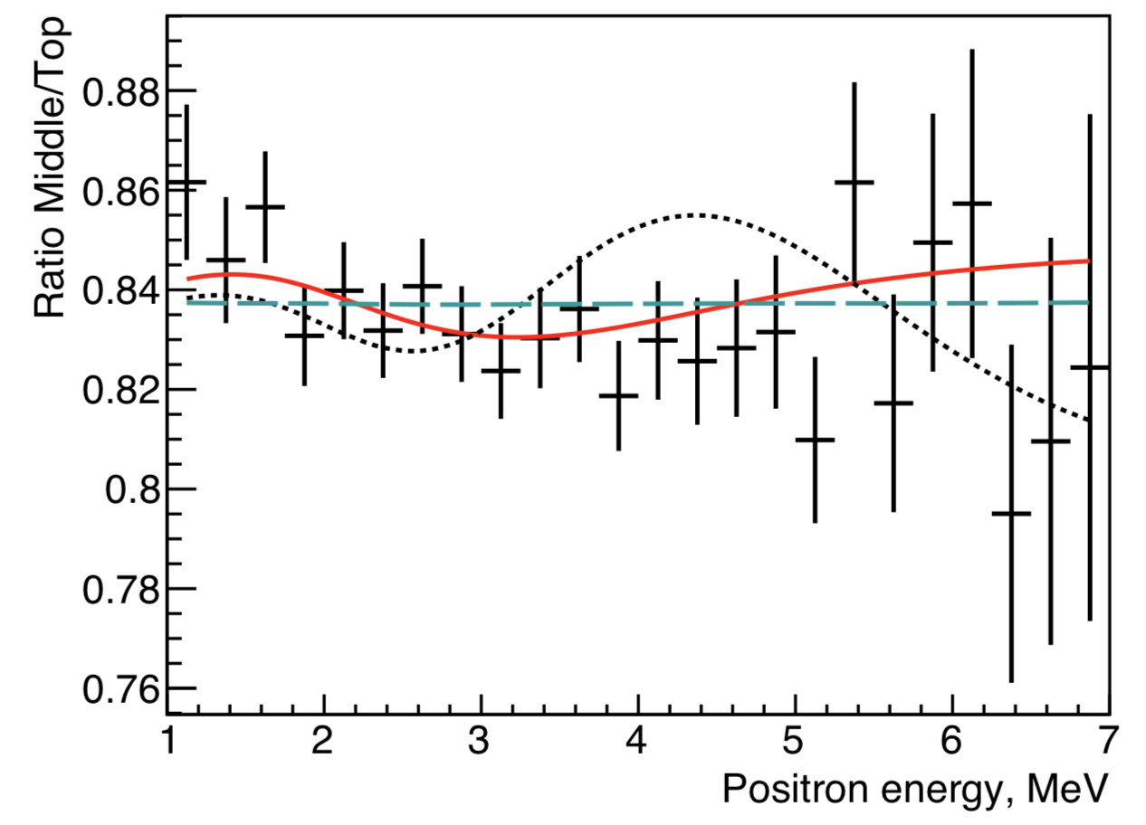
DANSS
Single Movable detector
[1810.01000 ]
[DANSS, Phys. Lett. B 787,56 (2018)]
Dentler et.al., JHEP 1808, 010 (2018)
Gariazzo et.al., Phys. Lett. B 782, 13 (2018)

Slide 15
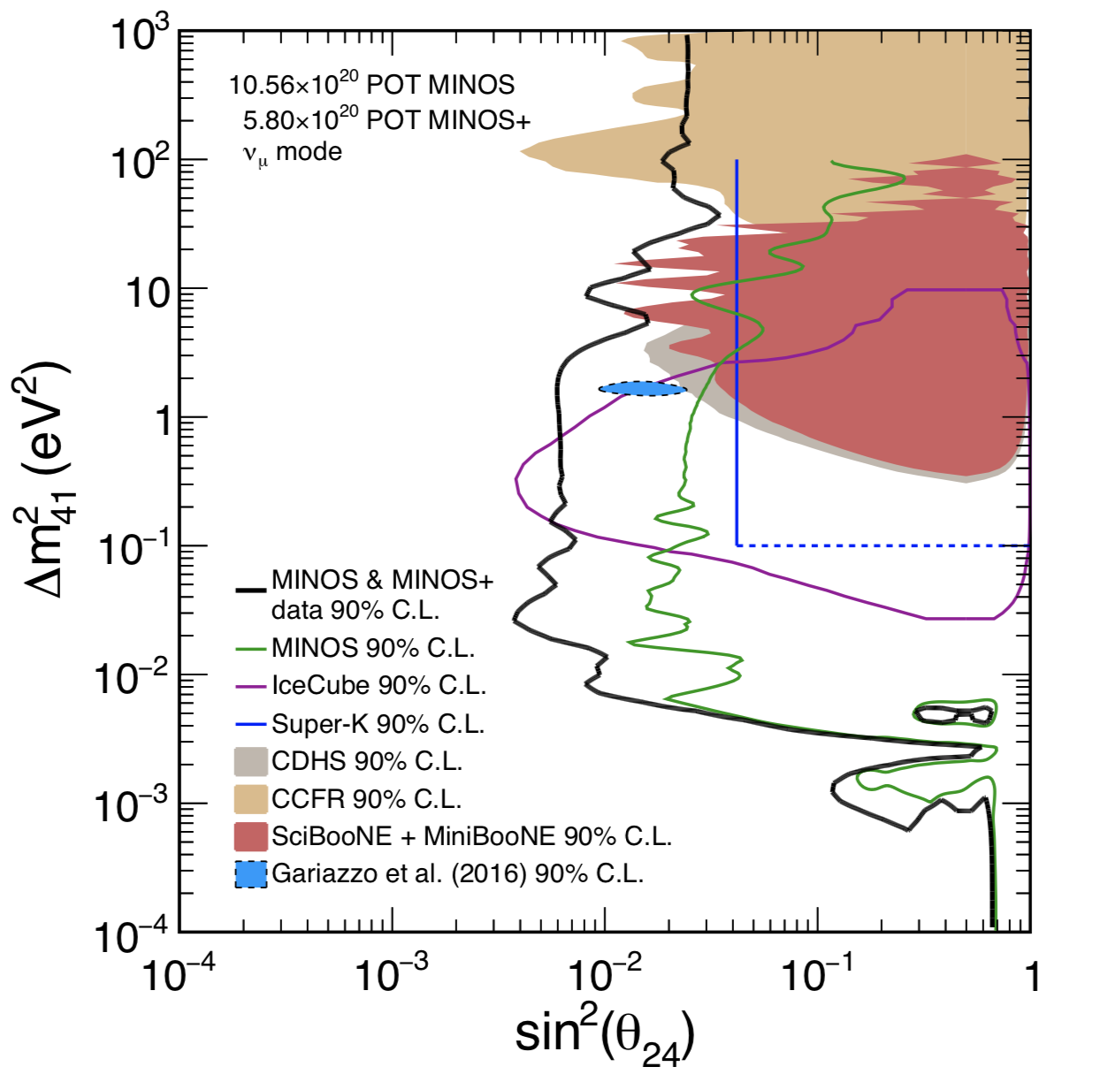
$ν_{μ}$(${\overline{ν}}_{μ}$) disappearance
IceCube
MINOS+
$$ν_{μ}$$
crust
mantle
core
$$μ$$
$$θ_{z}$$
1710.06488
If we take the results of MiniBooNE, MINOS+ and IceCube at face value, a baroque new physics scenario must be introduced to explain all the data.

Slide 16
Outline
Introduction
Tensions in light sterile neutrino searches
3+1 with NSI
Summary

Slide 17
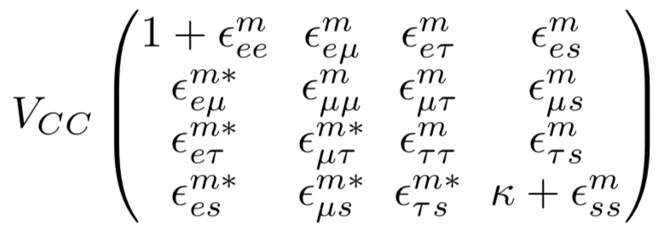
NSI to rescue 3+1
[Wolfenstein, Phys. Rev., D17, 2369 (1978)]
Neutrino propagation in matter
Neutrino production and detection
[Kopp et.al., Phys. Rev. D 77, 013007 (2008)]

Slide 18
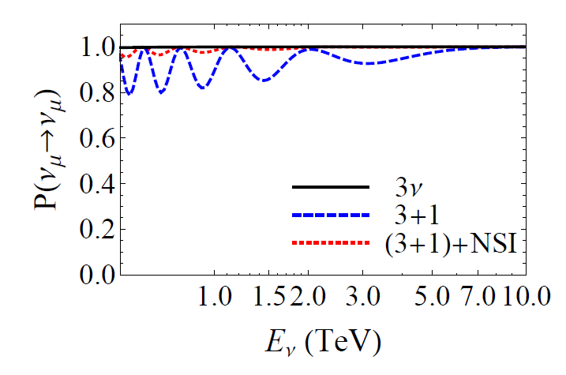
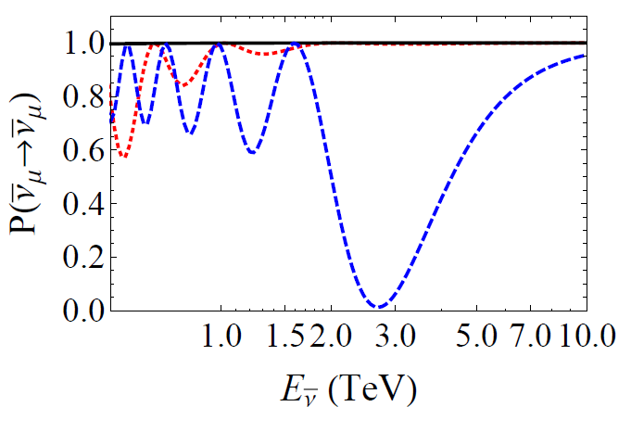
IceCube
H$=\frac{1}{2E_{ν}}U_{4}\left(\begin{matrix}\begin{matrix}0 & 0 \\ 0 & {δm}_{21}^{2}\end{matrix} & \begin{matrix}0 & 0 \\ 0 & 0\end{matrix} \\ \begin{matrix}0 & 0 \\ 0 & 0\end{matrix} & \begin{matrix}{δm}_{31}^{2} & 0 \\ 0 & {δm}_{41}^{2}\end{matrix}\end{matrix}\right)U_{4}^{†}$
$$±V_{CC}\left(\begin{matrix}\begin{matrix}1 & 0 \\ 0 & 0\end{matrix} & \begin{matrix}0 & 0 \\ 0 & 0\end{matrix} \\ \begin{matrix}0 & 0 \\ 0 & 0\end{matrix} & \begin{matrix}0 & 0 \\ 0 & κ\end{matrix}\end{matrix}\right)$$
Antineutrino oscillations with eV-mass sterile undergo resonance enhancement at TeV
[Nunokawa, et al., Phys. Lett. B 562, 279 (2003)]
$$V_{m}→V_{CC}\left(\begin{matrix}\begin{matrix}1 & 0 \\ 0 & 0\end{matrix} & \begin{matrix}0 & 0 \\ 0 & 0\end{matrix} \\ \begin{matrix}0 & 0 \\ 0 & 0\end{matrix} & \begin{matrix}0 & 0 \\ 0 & κ+ε_{ss}^{m}\end{matrix}\end{matrix}\right)$$
Resonance enhancement at TeV can be suppressed if $ε_{ss}^{m}$ are large
[Liao and Marfatia, Phys. Rev. Lett. 117, 071802 (2016)]

Slide 19
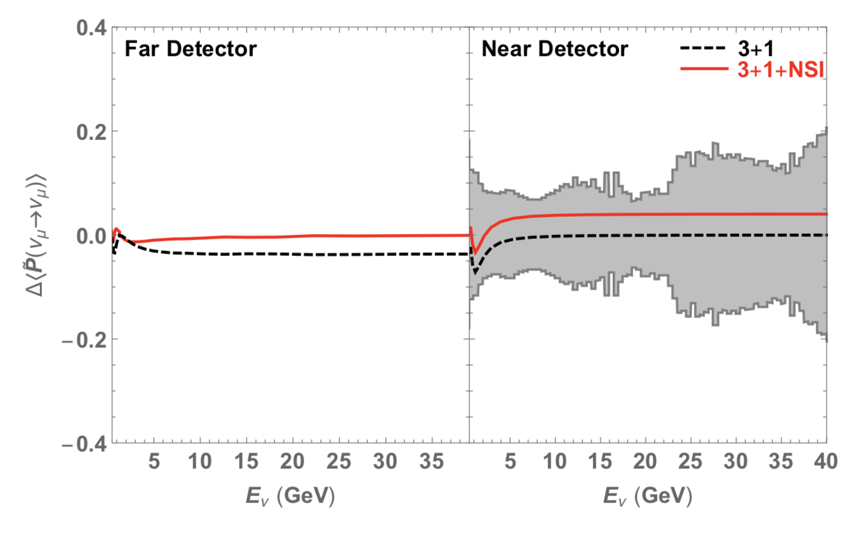
MINOS+
Occam’s razor: $ε_{μμ}^{D}, { ε}_{μμ}^{m}, ε_{ττ}^{m}, and ε_{ss}^{m}$
3+1+NSI survival prob at FD same as 3-neutrino case

Slide 20
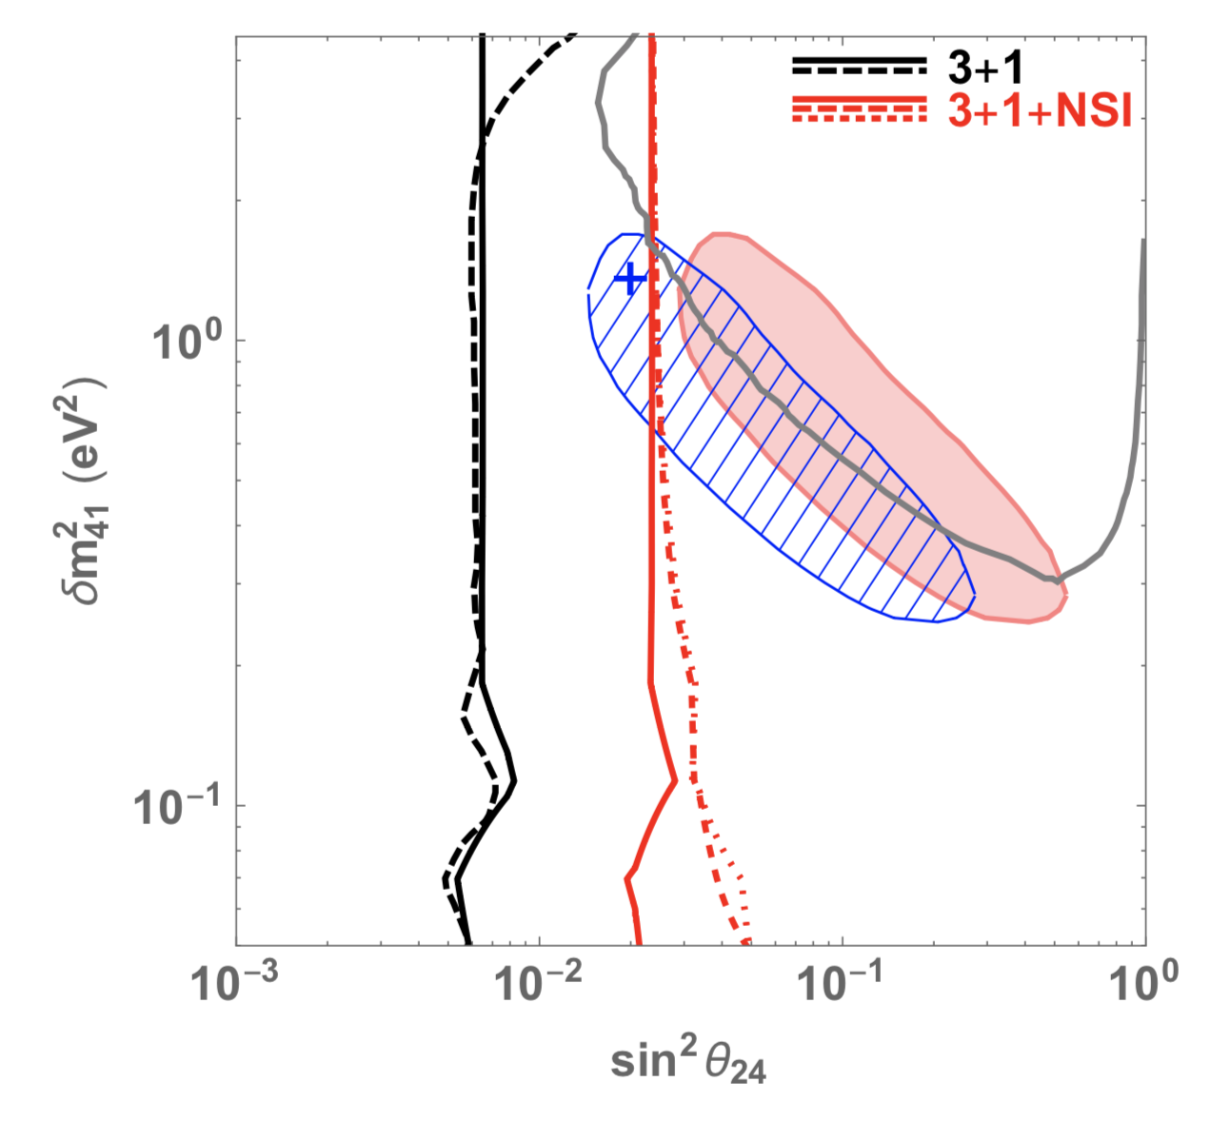
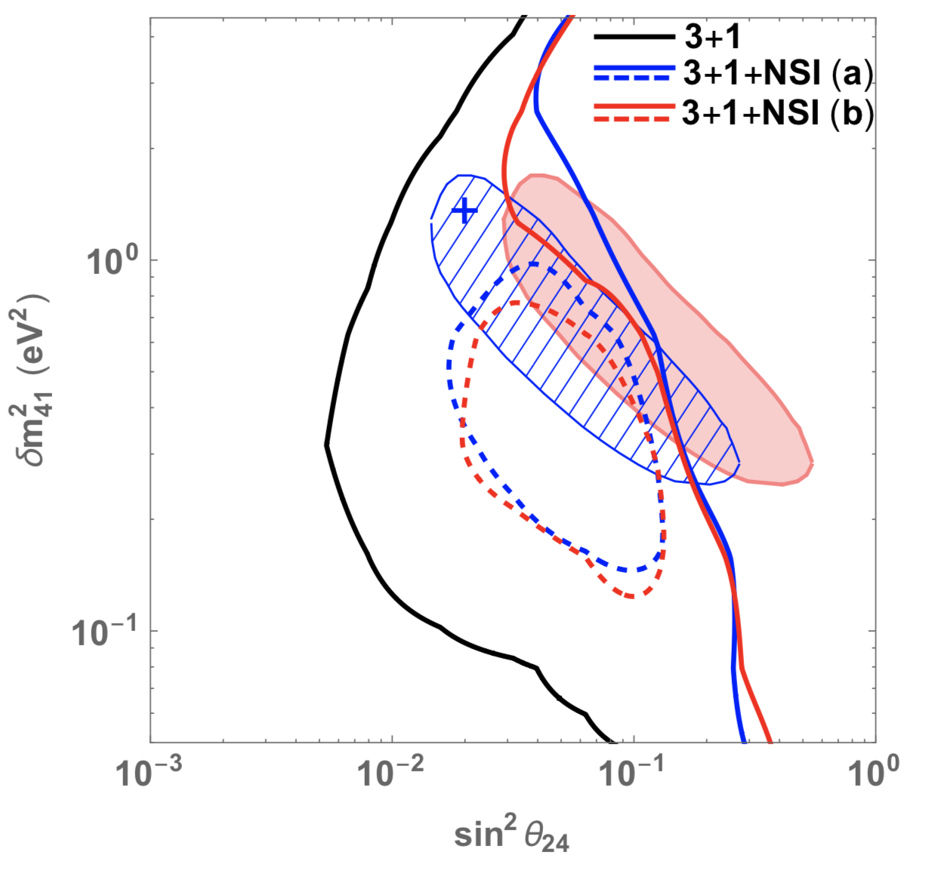
MINOS/MINOS+
IceCube/DeepCore
LSND+MiniBooNE
CDHS
$$ε_{μμ}^{D}=0.02$$
[Liao, Marfatia and Whisnant, Phys. Rev. D 99, 015016 (2019)]
3+1+NSI case with $ε_{μμ}^{D}=0.02$
(a) ${|ε}_{ττ}^{m}|<6$, ${|ε}_{ττ}^{m}−ε_{μμ}^{m}|<0.5$
(b) ${|ε}_{ss}^{m}|<6$, ${|ε}_{ττ}^{m}|<0.5$, ${|ε}_{ττ}^{m}−ε_{μμ}^{m}|<0.5$

Slide 21
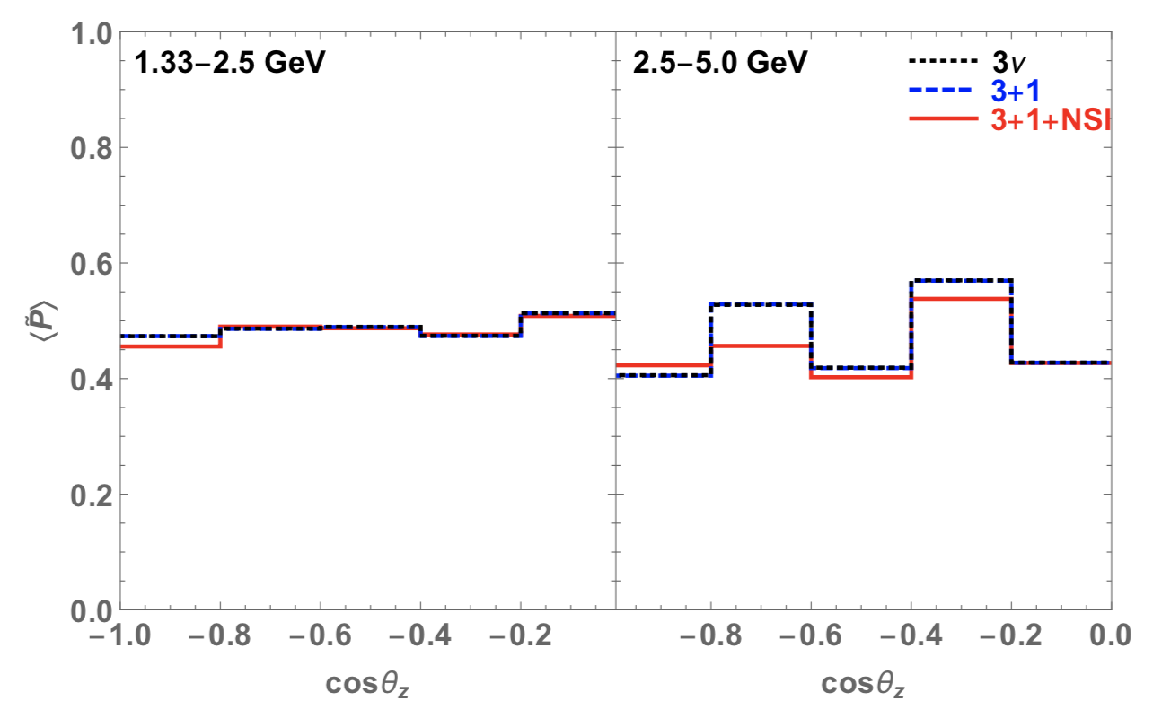
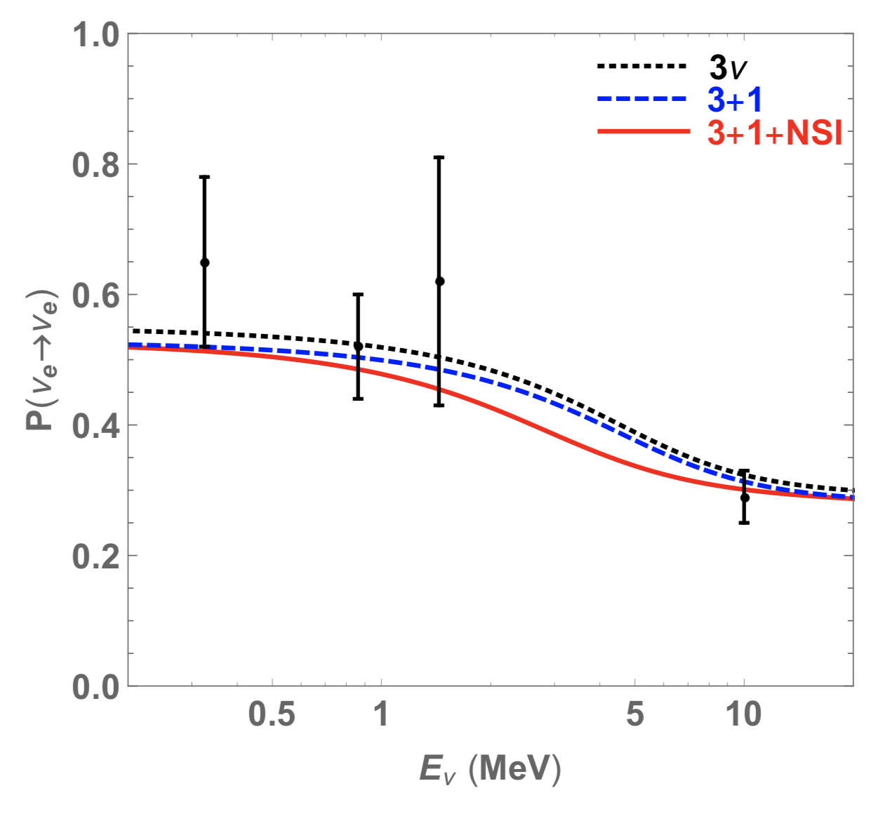
Other data
Super-K
Solar

Slide 22
Summary
MINOS+ and IceCube data present a big challenge to the simple 3+1 explanation of the LSND/MiniBooNE anomaly.
If the measurements of these experiments are accepted prima facie, a baroque new physics has to be introduced.
Sterile neutrino at MINOS+ can be canceled by CC NSI at the detector via $ε_{μμ}^{D}=\sin^{2}θ_{24}$.
IceCube bounds can be relaxed with large NC NSI $ε_{μμ}^{m}$ and $ε_{ττ}^{m}$, or large $ε_{ss}^{m}$ and small $ε_{μμ}^{m}$ and $ε_{ττ}^{m}$.

Slide 23
Thank you!

Slide 24
Backup slides

Slide 25
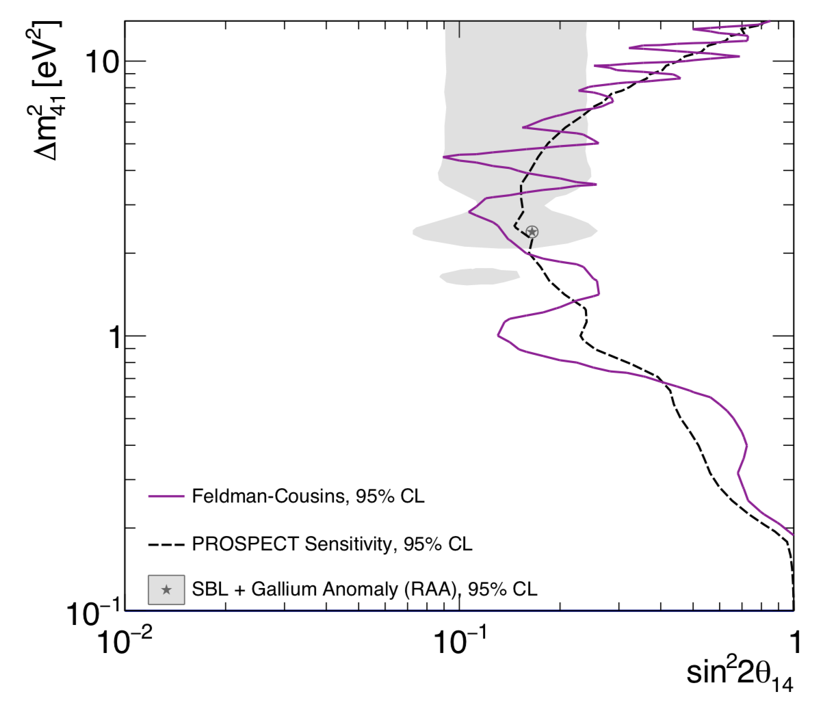
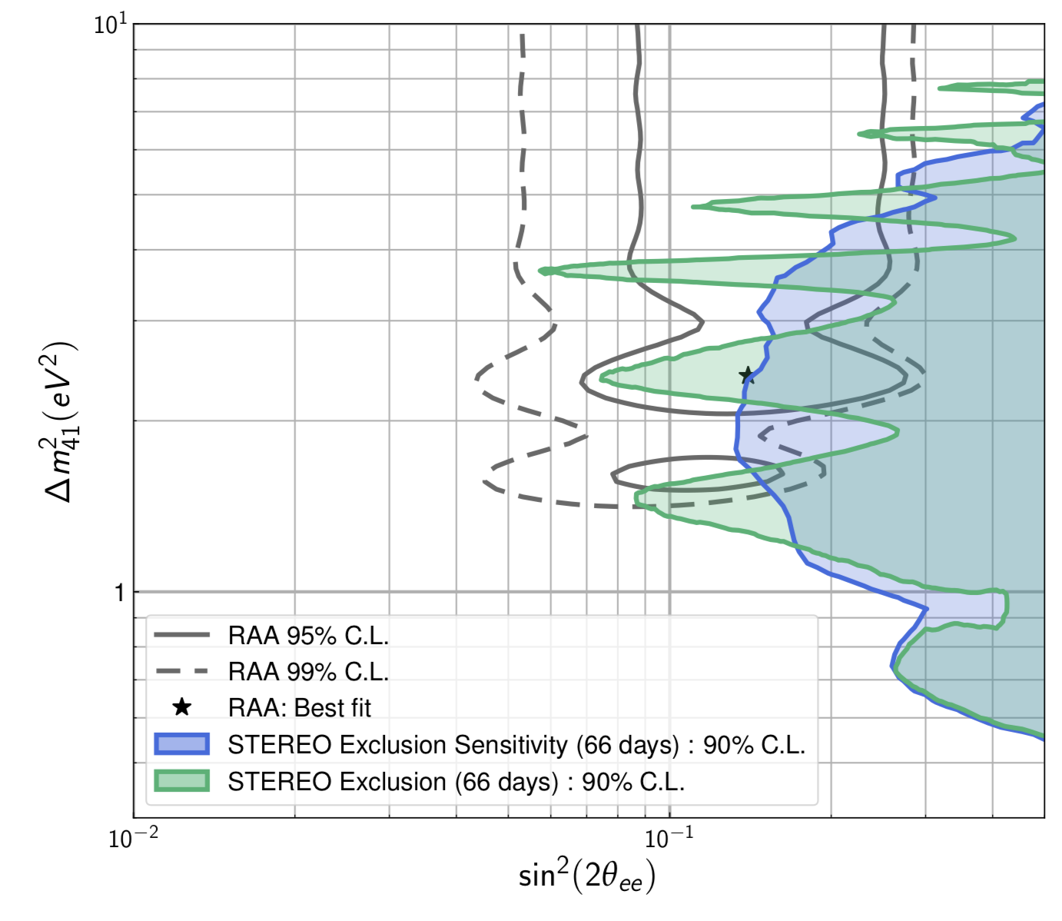
PROSPECT, 1806.02784
STEREO, 1806.02096

Slide 26
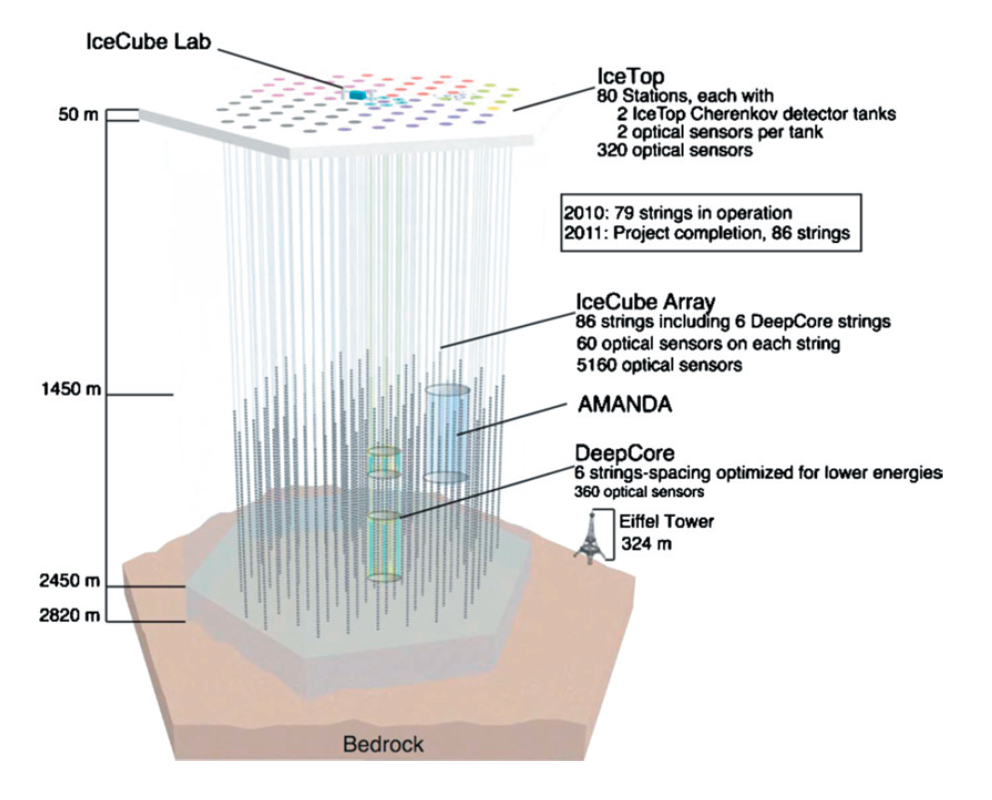
IceCube

Slide 27
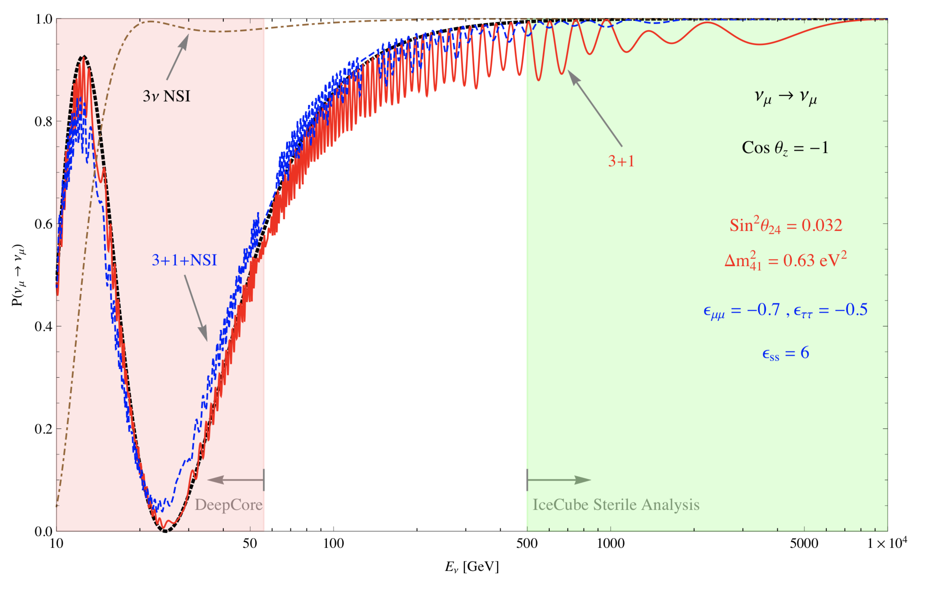
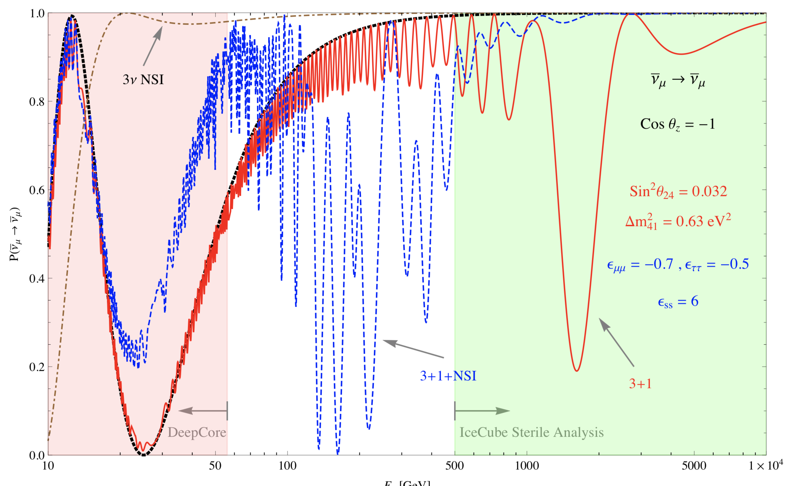
1810.11940v2

Slide 28
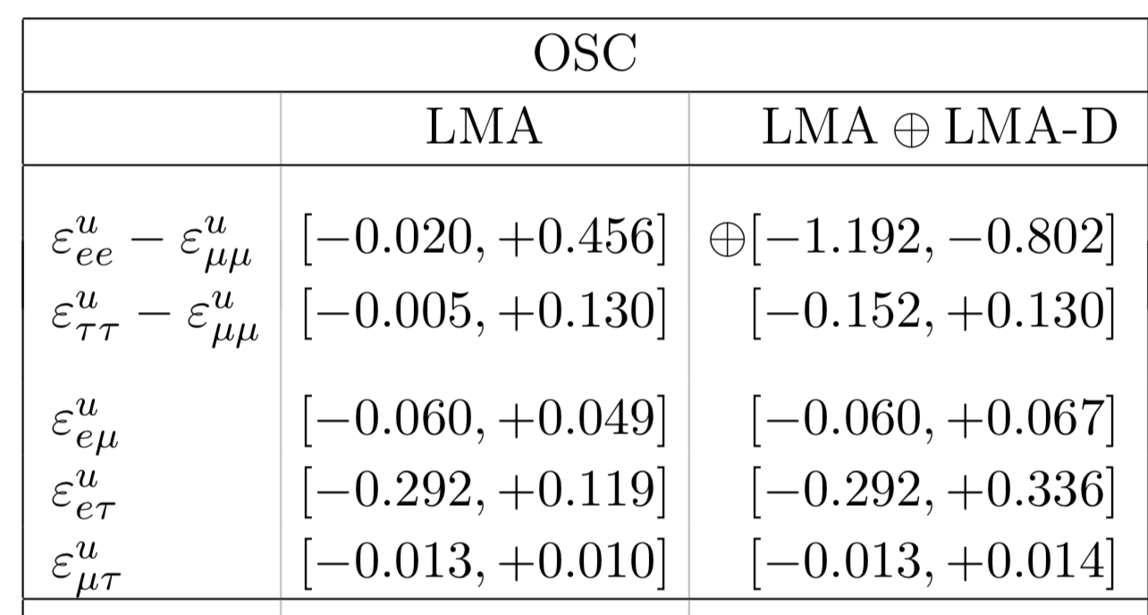
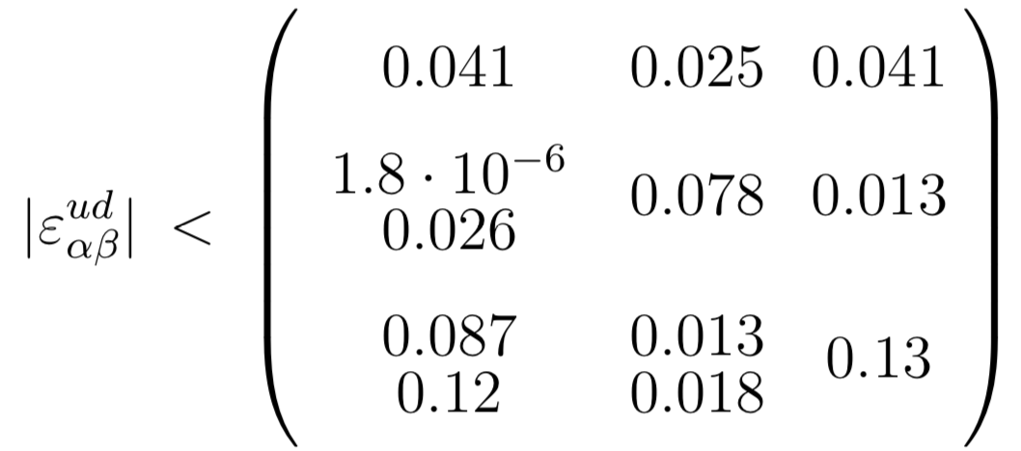
Constraints
NC NSI
CC NSI
1805.04530
0907.0097
Model independent bounds from neutrino oscillation data
allow large diagonal NSI parameters with O(1) differences between them

